Slide 1

Managed Security con la Power Platform: ¿De qué va esto?
Juan Carlos Gonzalez & Enrique Arribas
#BizzSummit2025
Notes:
Managed security con la Power Platform: ¿De que va esto?

Slide 2
Instrucciones para el uso de la PPT
Querido Speaker, te recordamos algunas de las reglas básicas:
Si vas a realizar un workshop, la sesión será de 2h. Para las sesiones dispondrás de 50 minutos.
No elimines la slide #5, utiliza la slide #1 o #2 a tu gusto y mantén la slide de patrocinadores. Tómate unos segundos para agradecerles su confianza y apoyo ☺
Reutiliza o personaliza a tu gusto la slide #6 con tu información (incluso cambia la fotografía).
Nuestra fuente para todo el contenido es Segoe UI.
No modifiques el patrón de diapositivas.
Por favor sigue la gama de colores establecida en la plantilla y solo añade colores adicionales cuando sea necesario para tu presentación.
Esta plantilla podría sufrir alguna modificación, no te preocupes si tu sesión queda grabada/preparada con una versión antigua.
Una vez hayas cumplido todo lo listado ☺ Siéntete libre de eliminar esta slide de tu presentación.

Slide 3

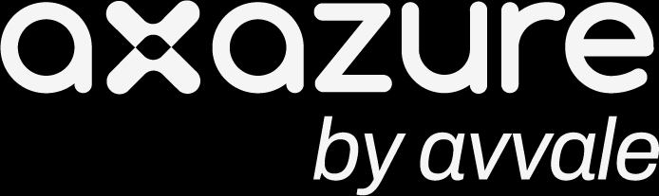













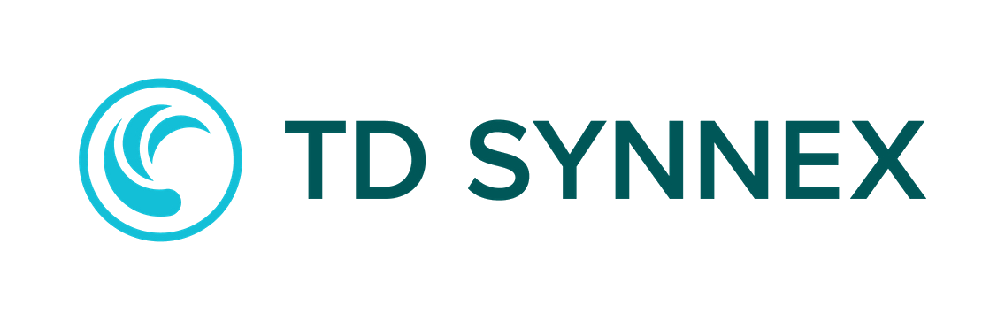






¡Gracias a nuestros sponsors!
PLATINO
ORO
PLATA
BIZZ SUMMIT TV & CATERING
COLABORAN

Slide 4


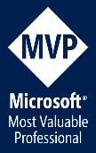

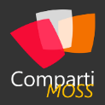
SPEAKER
Juan Carlos Gonzalez
Microsoft 365 SME & Delivery Manager en @Ricoh España con + de 22 Años de experiencia trabajando con plataformas y productos de Microsoft
Microsoft 365 & Microsoft 365 Copilot MVP | Creador de Contenidos en youtube.com/@jcgonzalezmartin
https://www.linkedin.com/in/juagon/
https://x.com/jcgm1978
https://youtube.com/@jcgonzalezmartin
4

Slide 5

SPEAKER
Enrique Arribas
Arquitecto de IA & Power Platform en @Ricoh España con + de 10 Años de experiencia trabajando con plataformas y productos de Microsoft
https://es.linkedin.com/in/enrique-arribas-bueno-2b3b4975
5

Slide 6
Agenda
1
Proteger Datos y Plataformas: ¿Compromiso u obligación?
4
Securizando la Identidad, el Acceso y la Red en la Power Platform
2
Postura de Seguridad y Managed Security en la Power Platform
5
Auditoría y Cumplimiento
3
Privacidad y Protección de Datos
6
Protección frente a amenazas
Notes:
Protecting data and platforms is a must
Security Layers & Managed Security in the Power Platform
Identity & Access Management + Network Security
Data Access Management, Data Security and Data Loss Prevention
-----------------------------------------------------------------------------
Compliance: Implement robust compliance measures to safeguard organizational data and ensure adherence to industry regulations through features such as Customer Lockbox.
Data protection and privacy: Ensure that personal information is securely handled, stored, and protected in a way that maintains confidentiality and integrity and prevents unauthorized access. Features such as Azure Virtual Network, customer-managed keys, data policies, data masking, and Microsoft Purview Data Map help protect applications and cloud workloads from network-based cyberattacks.
Identity and access management: Ensure that only authorized users can access specific resources, through features such as IP firewall, IP cookie binding, Manage sharing, conditional access policies for individual apps, managed identities for Dataverse plug-ins, and privileged access.
Threat protection: Protect your organization's assets and resources through unified detection by using Microsoft Sentinel solution for Power Platform. This solution allows for intelligent detection and responses to suspicious activities, such as mass data deletion or unauthorized app execution. In this way, it enhances your security posture and effectively mitigates potential threats.

Slide 7
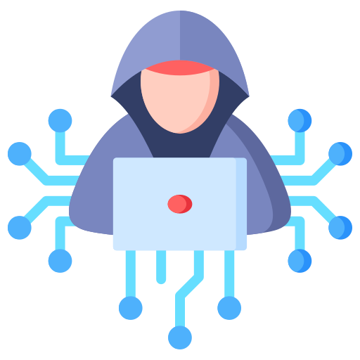

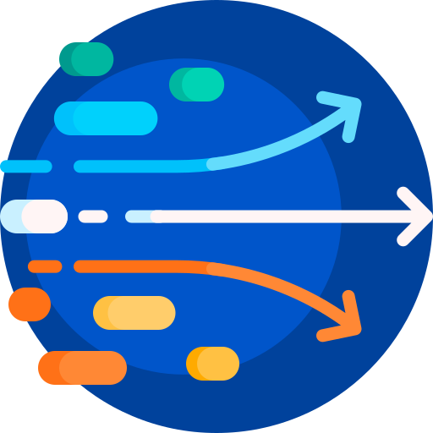

Proteger Datos y Plataformas: ¿Compromiso u Obligación?
Los ataques son cada vez más y más sofisticados
La explosión de escenarios de IA requiere asegurar un acceso correcto y seguro a los datos
Demanda de acceso a datos por un número creciente y dinámico de usuarios
Requerimientos legales y regulatorios en constante evolución
Notes:
Proteger Datos y Plataformas: ¿Compromiso u obligación

Slide 8

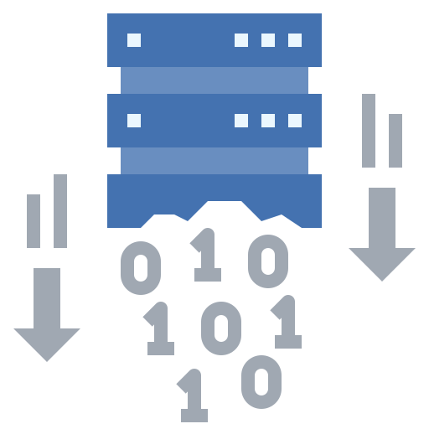

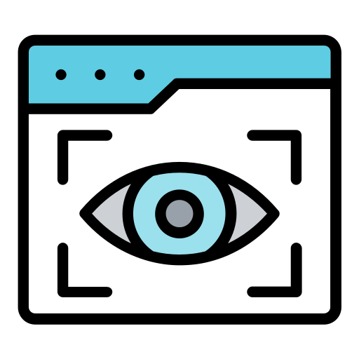

¿Cómo securizo datos y aplicaciones en la Power Platform?
Controlando y limitando el acceso a los datos
Previniendo filtraciones de datos
Cumpliendo las regulaciones y normas
Protegiendo los datos frente a amenazas externas
Con visibilidad de la actividad de usuario
Realizando evaluaciones de riesgos
Notes:
Proteger Datos y Plataformas: ¿Compromiso u obligación

Slide 9

Las 10 vulnerabilidades de seguridad top en Low Code/No Code
Account impersonation
Misuse of authorization
Data leakage and unexpected consequences
Failures of authentication and secure communication
Misconfigured security
Injection handling failures
Vulnerable and untrusted components
Failure to handle data and secrets properly
Failure to manage assets securely
Failures of security logging and monitoring
1
6
2
7
3
8
4
9
10
5
Notes:
Account impersonation -> SQL -> EAB: preguntar al público: ¿cuántos sabéis qué copnsecuencias tiene compartir una conexión en Power Platform?
Misuse of authorization -> Rol (autenticacion vs autorizacion)
Data leakage and unexpected consequences -> origen datos mal compartido
Failures of authentication and secure communication -> power pages
Misconfigured security -> charla
Injection handling failures -> injeccion en sql
Vulnerable and untrusted components -> PCF
Failure to handle data and secrets properly -> como se guarda. HTTP conector
Failure to manage assets securely -> muchas apps y usuarios que se mueven
Failures of security logging and monitoring -> insights

Slide 10
Security posture management
Managed Security en la Power Platform
Data protection and privacy
Identity and access management
Advanced protection for an AI-driven world
Compliance
Threat protection
Notes:
Postura de Seguridad en el Power Platform Admin Center
¿Postura de Seguridad en Microsoft Purview?

Slide 11

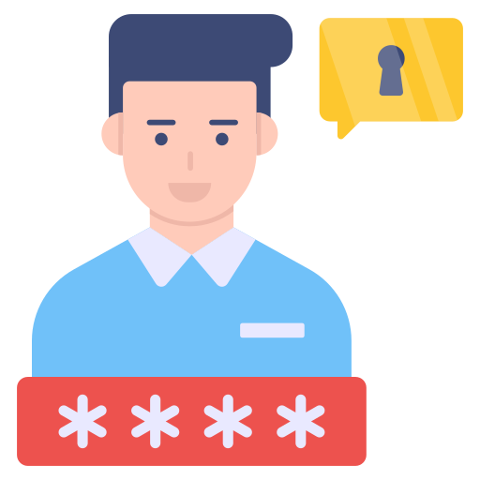
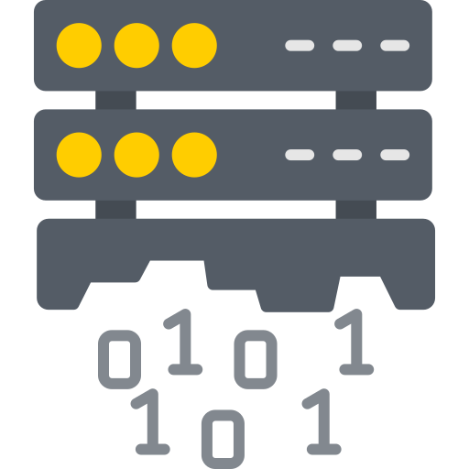
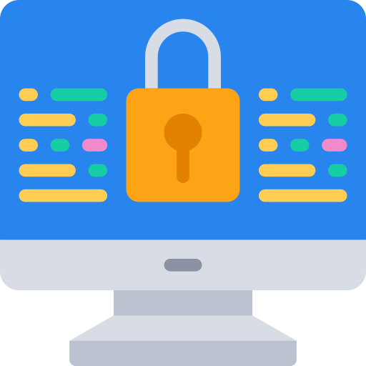
Update?
Capas de Seguridad en la Power Platform
Gestión de Identidades y Seguridad de Red
Gestión de Acceso de Usuarios y Seguridad del Dato
Prevención de fugas de Datos + Monitorización
Encriptado de Datos y Cumplimiento
Notes:
Proteger Datos y Plataformas: ¿Compromiso u obligación

Slide 12
Managed Security en la Power Platform
Advanced protection for an AI-driven world
Security Posture Management
Data Protection
and Privacy
Identity and Access
Management + Network Security
Compliance
Threat Protection
Intelligent guidance for scalable and efficient enterprise-grade security.
Robust controls to ensure confidentiality and encryption, ensuring security of sensitive information.
Seamless and adaptive tools to ensure only authorized resource and data access.
Assured visibility and adherence to industry and regional regulatory requirements.
AI-powered detection and monitoring to address and prevent security risks.
Security guidance
Customer managed keys
IP Firewall
Lockbox
Enforceable solution checker
Data masking
Resource sharing limits
Dataverse audit
Microsoft Sentinel integration
Microsoft Purview Data map integration
IP cookie binding
Thread Detection for Copilot Agents
Data policies (desktop flows)
Tenant Isolation
Microsoft Defender for Copilot Agents
Advanced connector policies
Privileged Access Management
Network
Isolation (v-Net)
Client app access
Conditional Access
Acceso a Agentes y Autenticación
Notes:
Data Protection & Privacy: Customer managed keys | Data masking | Microsoft Purview Data map | Data policies | Advaced connector policies | Network Isonaliton (v-Net)
Identity & Acces Management + Network Security: IP Firewall | Resource sharing limits | IP cookie binding | Tenant Isolationt | PIM | Client app Access | Conditional Access for Individual Canvas Apps | Agent Access & Authentication
Compliance: Lockbox | Dataverse Audid
Thread Protection: Solution Checker | Microsfot Sentinel Integration | Thread Detection for Copilot Agents | Microsoft Defender for Copilot Agents

Slide 13
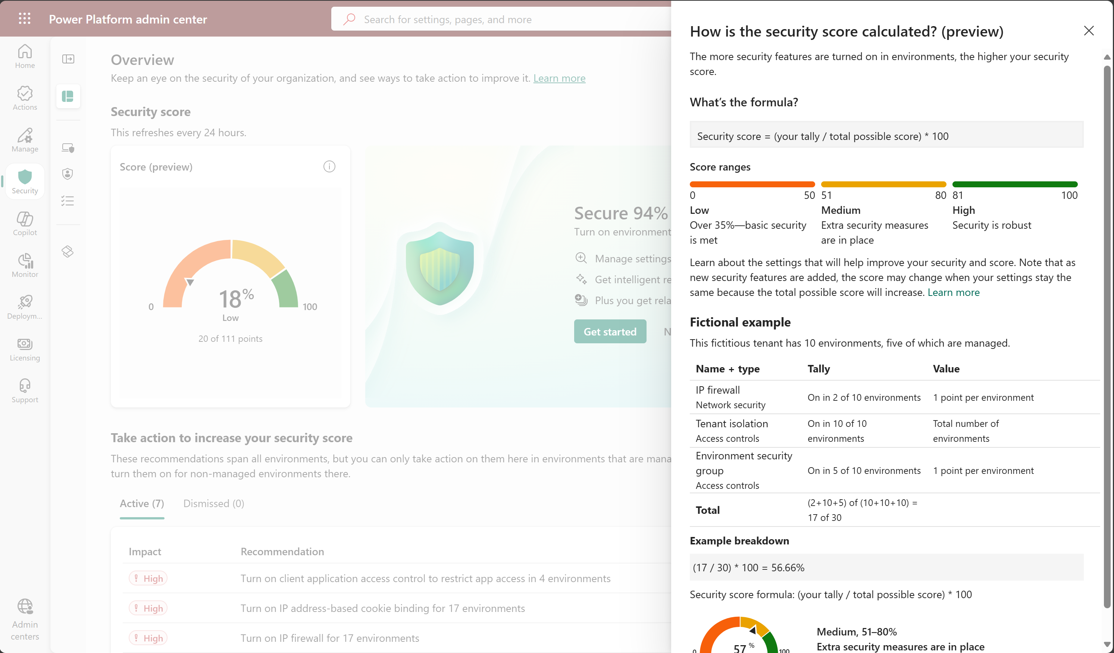
Postura de Seguridad de la Power Platform

Slide 14

DEMO #1
Postura de Seguridad en la Power Platform
Notes:
Postura de Seguridad en el Power Platform Admin Center
¿Postura de Seguridad en Microsoft Purview?

Slide 15



Privacidad y Protección de Datos
Se trata de asegurar que la información personal se gestiona, almacena y protege de forma segura manteniendo su confidencialidad e integridad, así como previniendo accesos no autorizados
Clave de encriptación auto-gestionada
Impide el acceso a los datos corporativos a todo el mundo “ajeno” a la organización
Proteger información sensible cuando el usuario interactúa con esta + Prevenir fugas de datos
Ofusca los datos remplazando los datos sensibles con cadenas de texto
Se basa en definir reglas de ofuscación usando expresiones regulares y caracteres para ocultar los datos sensibles
Gobierno y Descubrimiento de Datos de la Power Platform (Dataverse)
Clasificación de los Datos + Aplicación de Etiquetas de Sensibilidad y políticas de cumplimiento
Customer Managed Keys
Data Masking (Preview)
Microsoft Purview Data Map
Notes:
Data Protection & Privacy: Customer managed keys | Data masking | Microsoft Purview Data map | Data policies | Advaced connector policies | Network Isonaliton (v-Net)
Data protection and privacy: Ensure that personal information is securely handled, stored, and protected in a way that maintains confidentiality and integrity and prevents unauthorized access. Features such as Azure Virtual Network, customer-managed keys, data policies, data masking, and Microsoft Purview Data Map help protect applications and cloud workloads from network-based cyberattacks.
Data Masking: Data masking helps protect sensitive information during customer interactions and prevents data leaks. Data masking, also known as de-identification or obfuscation, replaces sensitive data with masked strings. The masked strings ensure that the original, unmasked values remain hidden. Only authorized users can read the unmasked values—one record at a time. In the context of customer interactions, frontline support users are prevented from exposing sensitive information like credit card numbers, social security numbers, or any personal data.

Slide 16
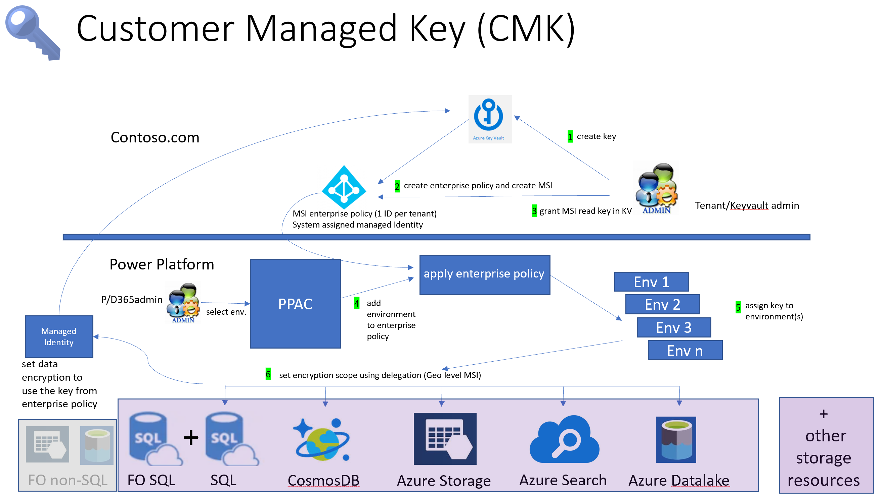
Privacidad y Protección de Datos
Manage your customer-managed encryption key - Power Platform | Microsoft Learn
Notes:
Data Protection & Privacy: Customer managed keys | Data masking | Microsoft Purview Data map | Data policies | Advaced connector policies | Network Isonaliton (v-Net)
Data protection and privacy: Ensure that personal information is securely handled, stored, and protected in a way that maintains confidentiality and integrity and prevents unauthorized access. Features such as Azure Virtual Network, customer-managed keys, data policies, data masking, and Microsoft Purview Data Map help protect applications and cloud workloads from network-based cyberattacks.
Data Masking: Data masking helps protect sensitive information during customer interactions and prevents data leaks. Data masking, also known as de-identification or obfuscation, replaces sensitive data with masked strings. The masked strings ensure that the original, unmasked values remain hidden. Only authorized users can read the unmasked values—one record at a time. In the context of customer interactions, frontline support users are prevented from exposing sensitive information like credit card numbers, social security numbers, or any personal data.

Slide 17
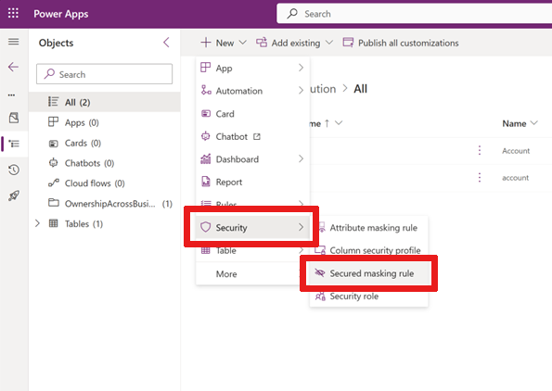
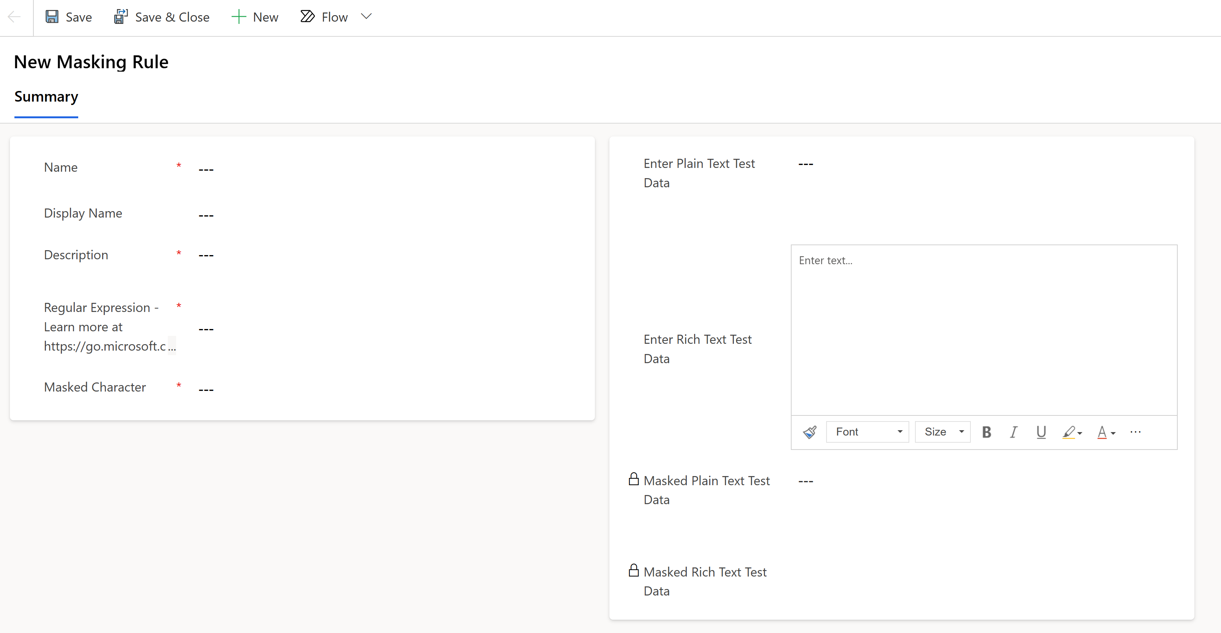
Privacidad y Protección de Datos
Create and manage masking rules (preview) - Power Platform | Microsoft Learn
1
2
Creamos regla de ofuscación en la Solución
Configuramos la regla de ofuscación

Slide 18
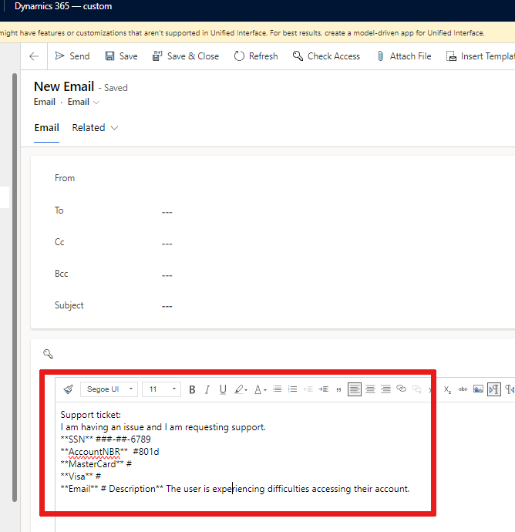
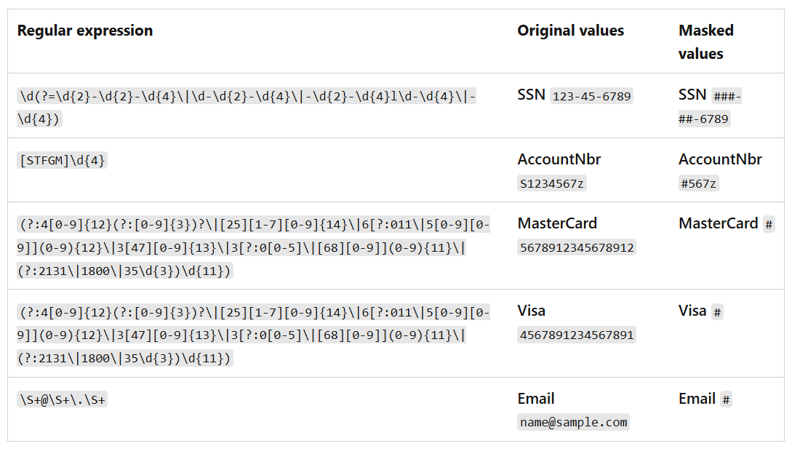
Privacidad y Protección de Datos
Create and manage masking rules (preview) - Power Platform | Microsoft Learn
3
Ejemplos de ofuscación
4
Lo que ve el usuario

Slide 19

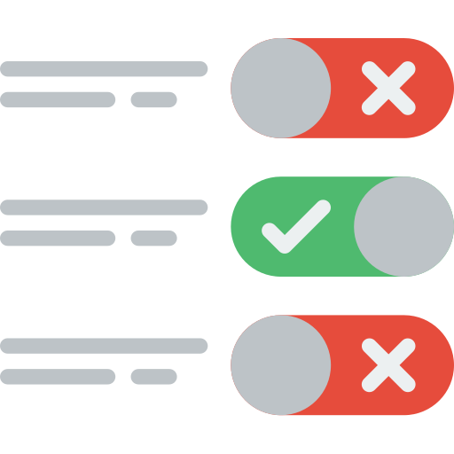

Privacidad y Protección de Datos
Prevenir que los makers puedan exponer información corporativa en tiempo de ejecución/en tiempo de diseño
Prevenir el uso de conectores bloqueados en Apps y Flows
3 ámbitos/niveles de aplicación: Global vs. Grupo de Entornos vs. Entorno
(En Preview) Administrar y aplicar políticas de conectores permitidos/bloqueados a escala (Grupo de Entornos)
Conexión desde la Power Platform a recursos privados sin exponerlos en Internet
La conectividad se realiza sin necesidad de rangos de IP de la Power Platform o de Tags de Servicio
Soporte para PlugIns y Conectores de Dataverse (solo Managed Environments)
Directivas de Datos + (en tiempo de diseño)
Directivas de Conector Avanzadas
Azure Virtual Network
Notes:
Data Protection & Privacy: Customer managed keys | Data masking | Microsoft Purview Data map | Data policies | Advaced connector policies | Network Isonaliton (v-Net)
Data protection and privacy: Ensure that personal information is securely handled, stored, and protected in a way that maintains confidentiality and integrity and prevents unauthorized access. Features such as Azure Virtual Network, customer-managed keys, data policies, data masking, and Microsoft Purview Data Map help protect applications and cloud workloads from network-based cyberattacks.
Advanced Connector Policies: Advanced connector policies (ACP) represent the next generation of securing connector usage within the Power Platform. This feature provides a modern and flexible approach to managing all certified connectors, aligning with the broader governance strategy of per-environment security controls paired with environment group support.
Azure Virtual Network:
Data protection: Virtual Network allows Power Platform services to connect to your private and protected resources without exposing them to the internet.
No unauthorized access: Virtual Network connects with your resources without needing Power Platform IP ranges or service tags in the connection

Slide 20
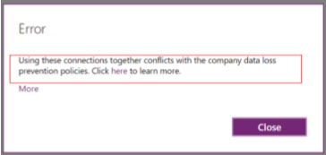
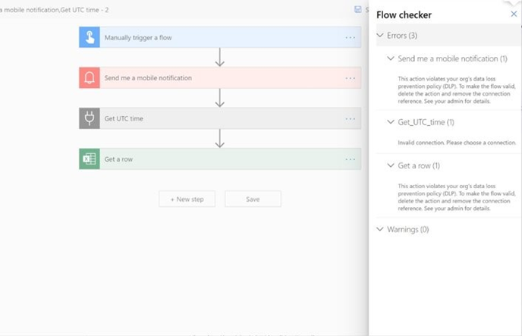
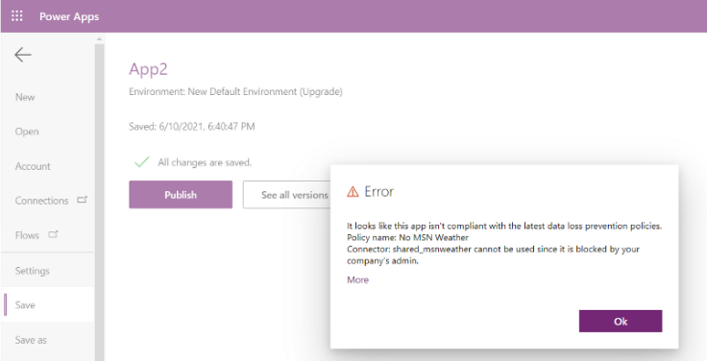
Privacidad y Protección de Datos
Impact of data policies on apps and flows - Power Platform | Microsoft Learn
Directiva de Datos en tiempo de diseño

Slide 21
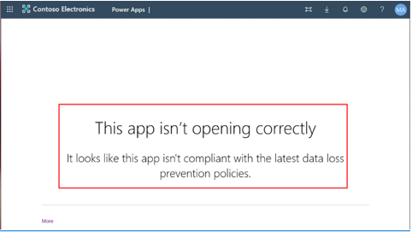
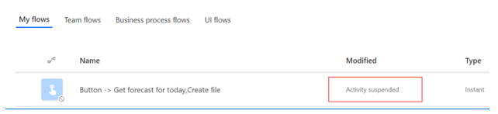
Privacidad y Protección de Datos
Impact of data policies on apps and flows - Power Platform | Microsoft Learn
Directivas de Datos en tiempo de ejecución

Slide 22
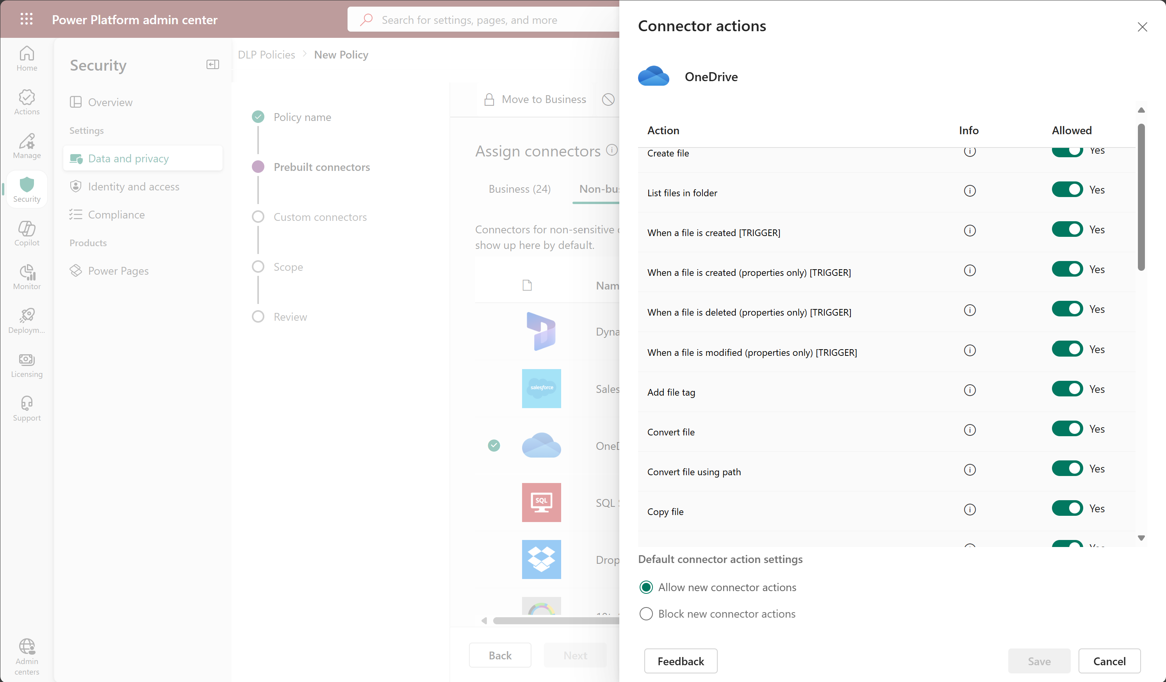
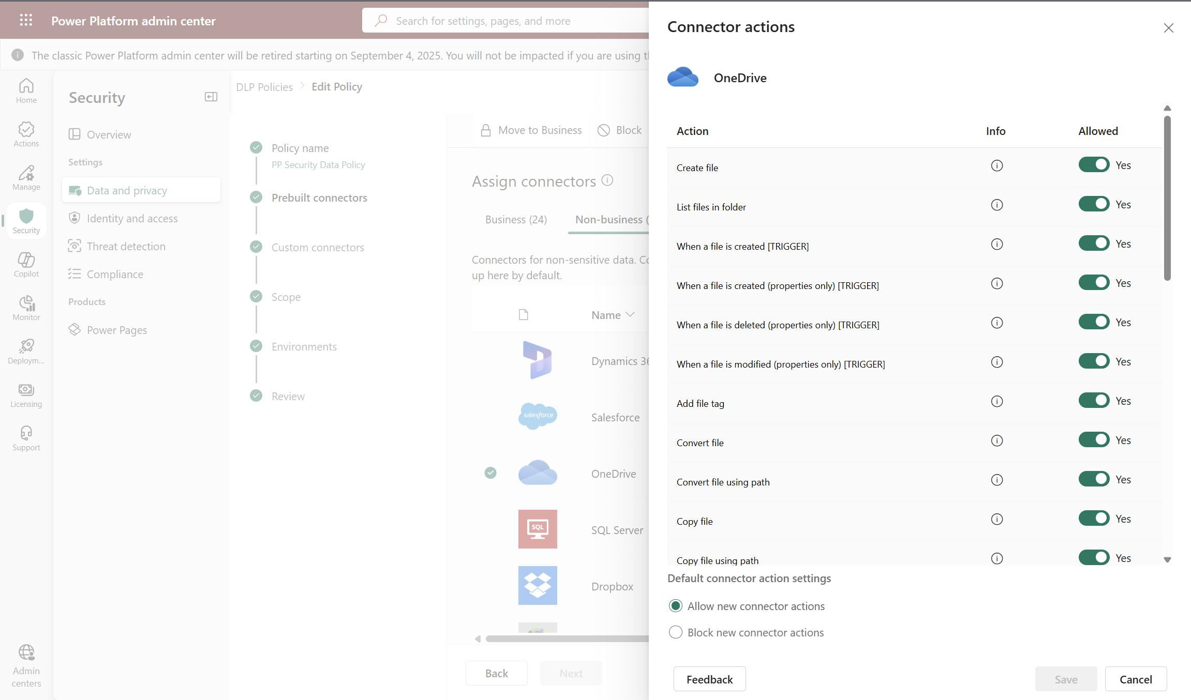
Privacidad y Protección de Datos
Connector action control - Power Platform | Microsoft Learn & Connector endpoint filtering (preview) - Power Platform | Microsoft Learn
Configuraciones de Acceso a Datos & Privacidad
1
Seleccionar un conector que se puede bloquear
Setup granular en acciones del conector
2
3
Permitir/Bloquear nuevas acciones de conector
4

Slide 23
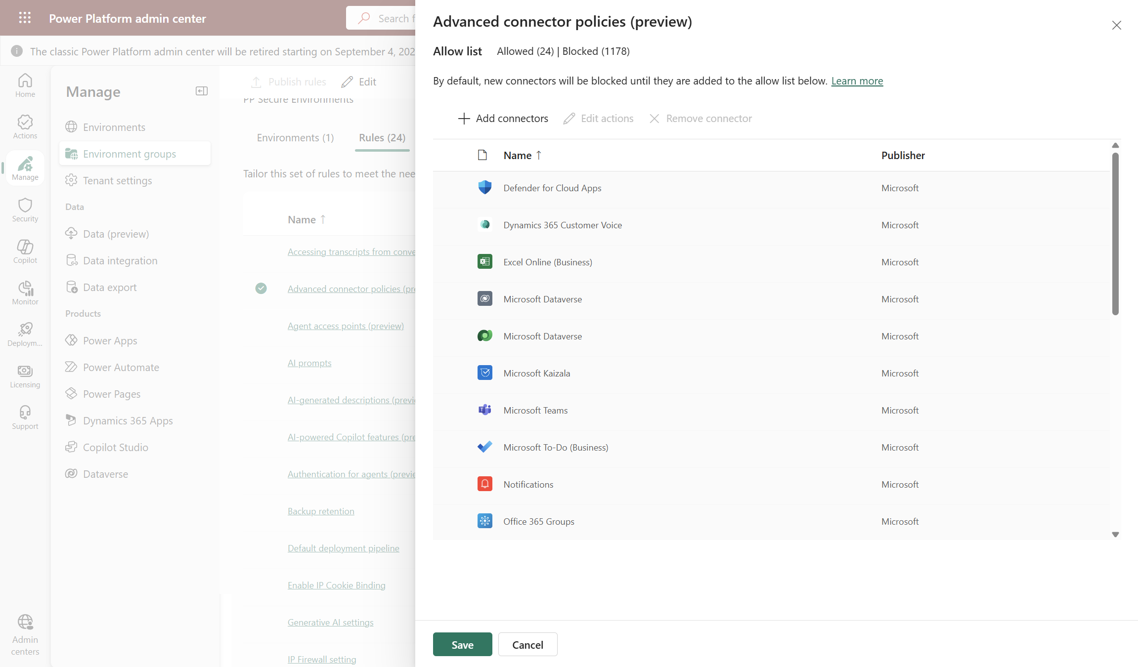
Privacidad y Protección de Datos
Advanced connector policies (preview) - Power Platform | Microsoft Learn
2
Directivas de Conectores Avanzadas
Añadir/Actualizar Conectores permitidos en el Grupo de Entornos
Acceso a Grupos de Entornos
3
1
Soporte de Conectores Certificados, Custom, Virtuales y MCP
4
Notes:
Advanced connector policies (ACP) represent the next generation of securing connector usage within the Power Platform. This feature provides a modern and flexible approach to managing all certified connectors, aligning with the broader governance strategy of per-environment security controls paired with environment group support.
By adopting advanced connector policies, administrators gain greater control and granularity in securing and managing connector usage while enhancing the overall governance of their Power Platform environments.
Data policies - Power Platform | Microsoft Learn

Slide 24
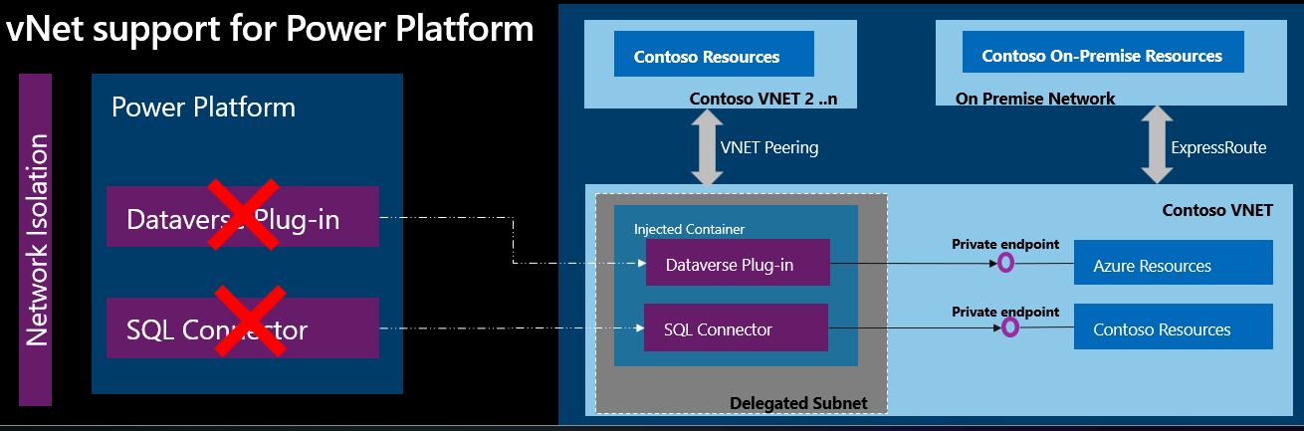
Privacidad y Protección de Datos
Virtual Network support overview - Power Platform | Microsoft Learn
Notes:
With Azure Virtual Network support for Power Platform, you can integrate Power Platform with resources inside your virtual network without exposing them over the public internet. Virtual Network support uses Azure subnet delegation to manage outbound traffic from Power Platform at runtime. Using Azure Subnet delegation avoids the need for protected resources to be available over the internet to integrate with Power Platform. With virtual network support, Power Platform components can call resources owned by your enterprise inside your network, whether they're hosted in Azure or on-premises, and use plug-ins and connectors to make outbound call

Slide 25
DEMO #2
Privacidad y Protección de los Datos
Notes:
Customer Key – Video in Microsoft Learn: https://learn.microsoft.com/en-us/power-platform/admin/customer-managed-key
Data Masking
Data Policies: Global vs. Grupo de Entornos vs. Entorno
Advaced Connector Policies
Soporte vNET? -> charla sigueinte de david oliva y elias manchon

Slide 26



Securizando la Identidad, el Acceso y la Red en la Power Platform
Asegurar que solo los usuarios autorizados pueden acceder a ciertos recursos
Prevenir que los makers puedan exponer información corporativa en tiempo de ejecución/en tiempo de diseño
Prevenir el uso de conectores bloqueados en Apps y Flows
3 ámbitos/niveles de aplicación: Global vs. Grupo de Entornos vs. Entorno
Limitar como los usuarios pueden compartir Aplicaciones, Flujos y Agentes
2 ámbitos/niveles de aplicación: Entorno vs. Grupo de Entornos
Conexión desde la Power Platform a recursos privados sin exponerlos en Internet
La conectividad se realiza sin necesidad de rangos de IP de la Power Platform o de Tags de Servicio
Soporte para PlugIns y Conectores de Dataverse (solo Managed Environments)
Restringir las conexiones entrantes/salientes del tenant en Aplicaciones y Flows
Permitir excepciones en base a necesidades del negocio
IP Firewall
Limites en compartición de recursos
IP Cookie Binding
Aislamiento de Tenant
Notes:
Identity and access management: Ensure that only authorized users can access specific resources, through features such as IP firewall, IP cookie binding, Manage sharing, conditional access policies for individual apps, managed identities for Dataverse plug-ins, and privileged access.
Identity & Acces Management + Network Security: IP Firewall | Resource sharing limits | IP cookie binding | Tenant Isolationt | PIM | Client app Access | Conditional Access for Individual Canvas Apps | Agent Access & Authentication
IP Firewall: The IP firewall feature in Microsoft Power Platform is a security control that applies only to Managed Environments with Dataverse. It provides a critical layer of security by controlling inbound traffic to Power Platform environments. Administrators can use this feature to define and enforce IP-based access controls. In this way, they can ensure that only authorized IP addresses can access the Power Platform environment. By using IP firewall, organizations can mitigate risks that are associated with unauthorized access and data breaches, and therefore enhance the overall security of their Power Platform deployments. Learn more in IP firewall in Power Platform environments.
Resource Sharing Limits: In Managed Environments, admins can limit how broadly users can share canvas apps, flows, and agents.
IP Cookie Binding: Prevent session hijacking exploits in Dataverse with IP address-based cookie binding. Let's say that a malicious user copies a valid session cookie from an authorized computer that has cookie IP binding enabled. The user then tries to use the cookie on a different computer to gain unauthorized access to Dataverse. In real time, Dataverse compares the IP address of the cookie's origin against the IP address of the computer making the request. If the two are different, the attempt is blocked, and an error message is shown.
Power Platform tenant Isolation: Power Platform tenant isolation is different from Microsoft Entra ID-wide tenant restriction. It doesn't impact Microsoft Entra ID-based access outside of Power Platform. Power Platform tenant isolation only works for connectors using Microsoft Entra ID-based authentication such as Office 365 Outlook or SharePoint.

Slide 27
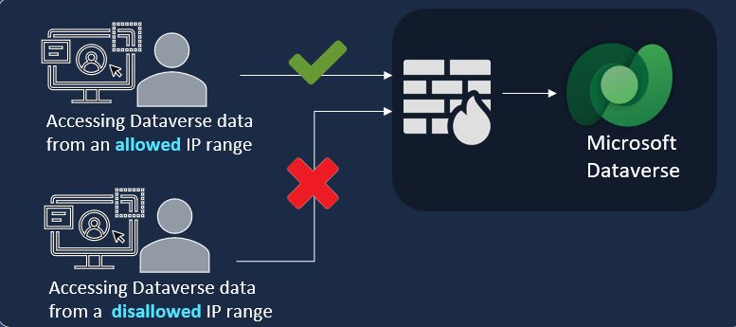
Securizando la Identidad, el Acceso y la Red en la Power Platform
IP Firewall para un entorno
IP firewall in Power Platform environments - Power Platform | Microsoft Learn

Slide 28
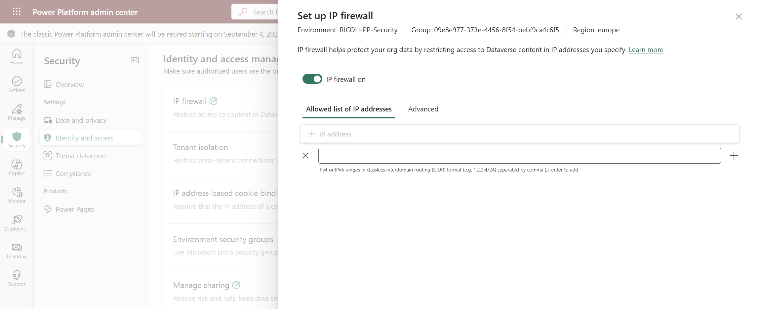
Securizando la Identidad, el Acceso y la Red en la Power Platform
IP Firewall para un entorno o un Grupo de Entornos
IP Firewall
2
IP Firewall habilitado para el entorno
3
Identity & Access Management
Direcciones IP o Rango de Direcciones IP
4
1

Slide 29
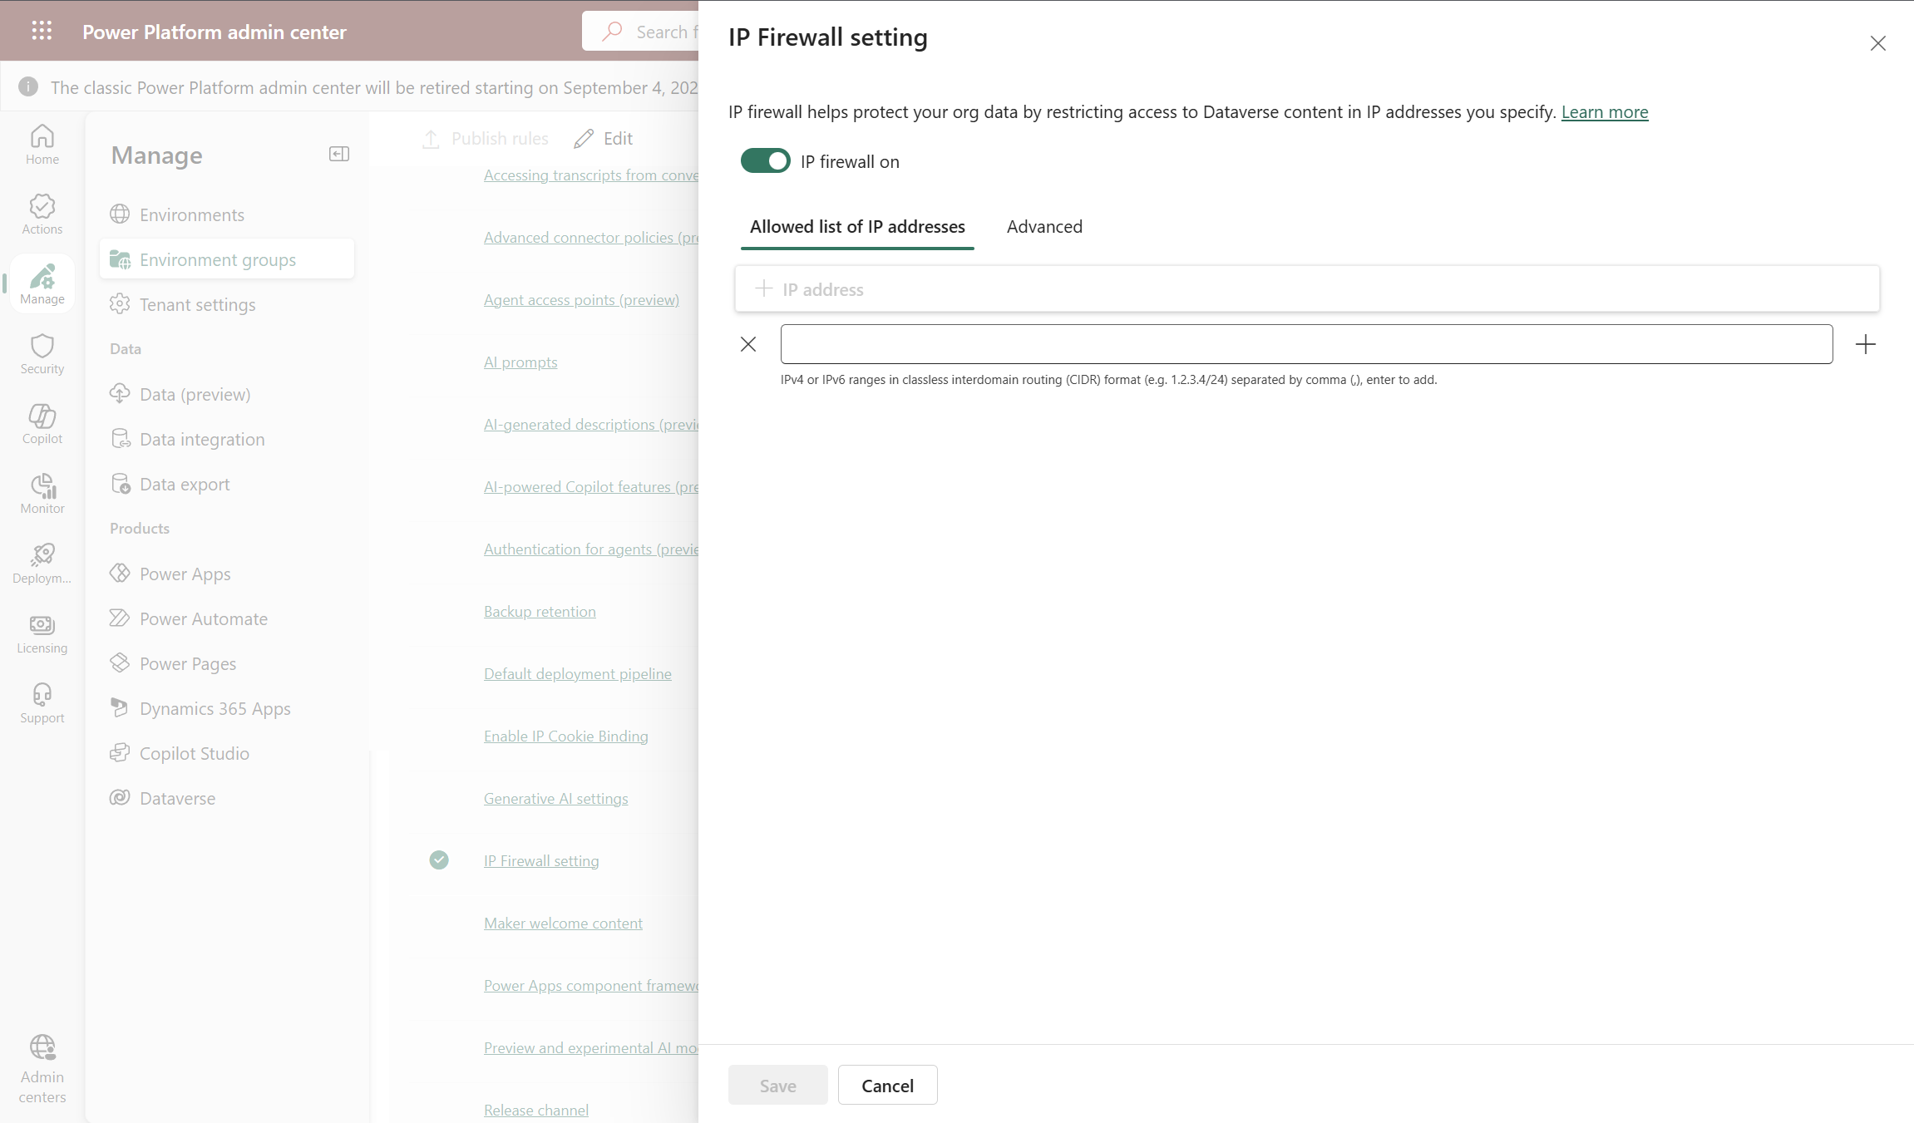
Securizando la Identidad, el Acceso y la Red en la Power Platform
IP Firewall para un grupo de entornos
IP Firewall habilitado para el grupo de entornos
2
Direcciones IP o Rango de Direcciones IP
3
IP Firewall settings for the Env. Group
1

Slide 30
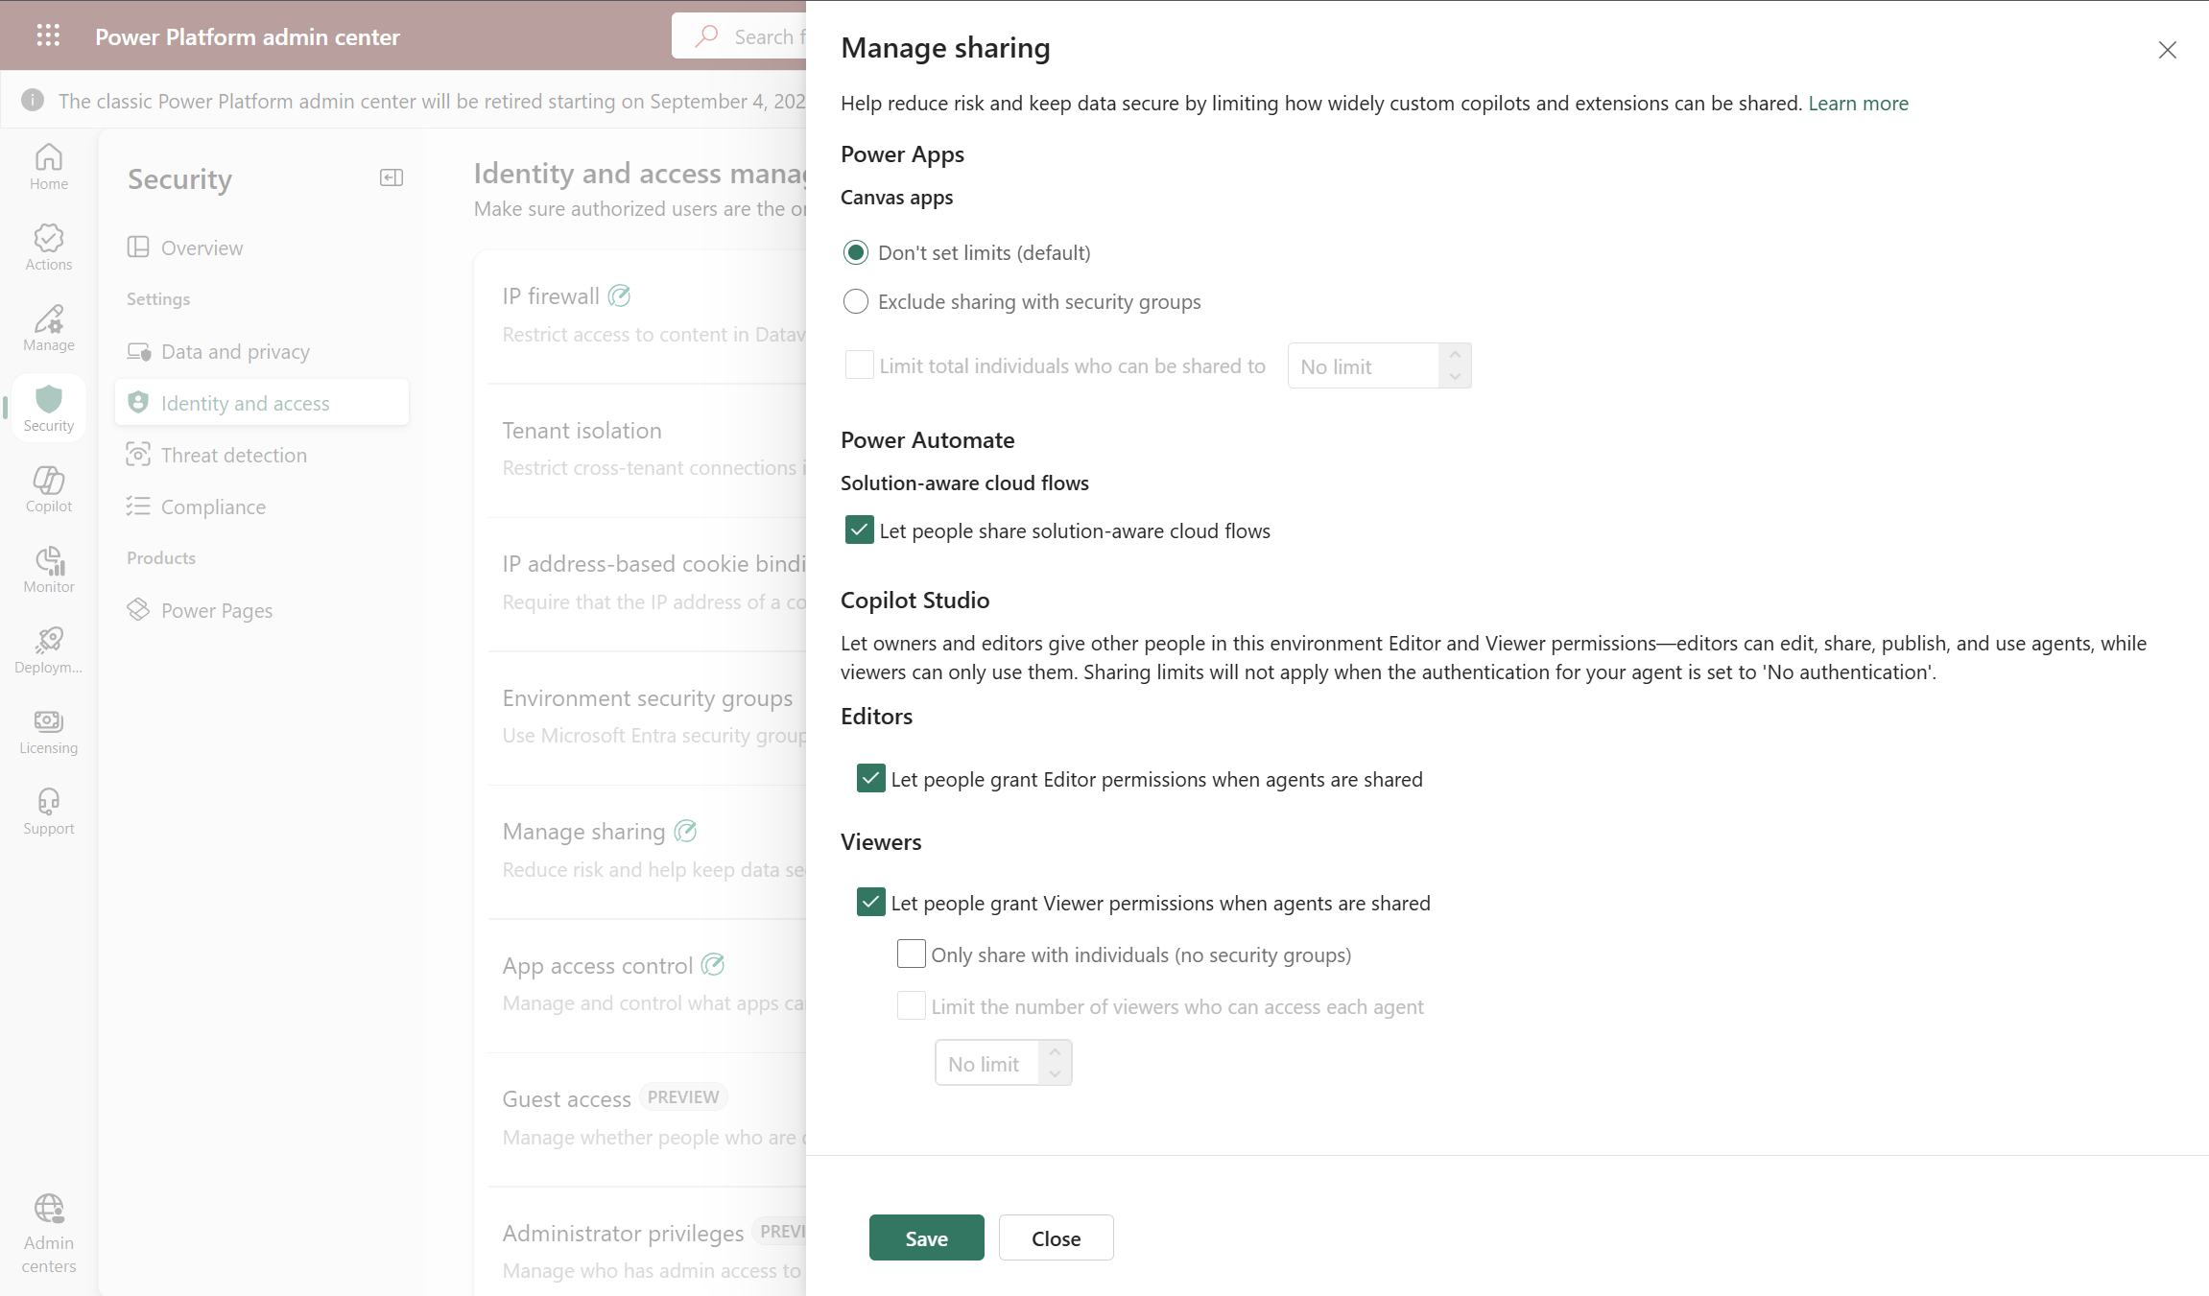
Securizando la Identidad, el Acceso y la Red en la Power Platform
Limit sharing - Power Platform | Microsoft Learn – Para un entorno o un Grupo de Entornos
Canvas Apps Sharing settings
3
Power Automate Sharing settings
Identity & Access Settings
4
Copilot Studio Sharing settings
1
5
Manage sharing setting
2

Slide 31
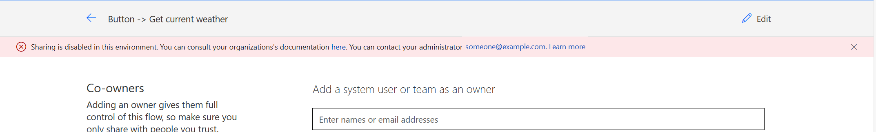
Securizando la Identidad, el Acceso y la Red en la Power Platform
Efecto de la configuración de compartir en una App cuando se incumple la configuración aplicada

Slide 32
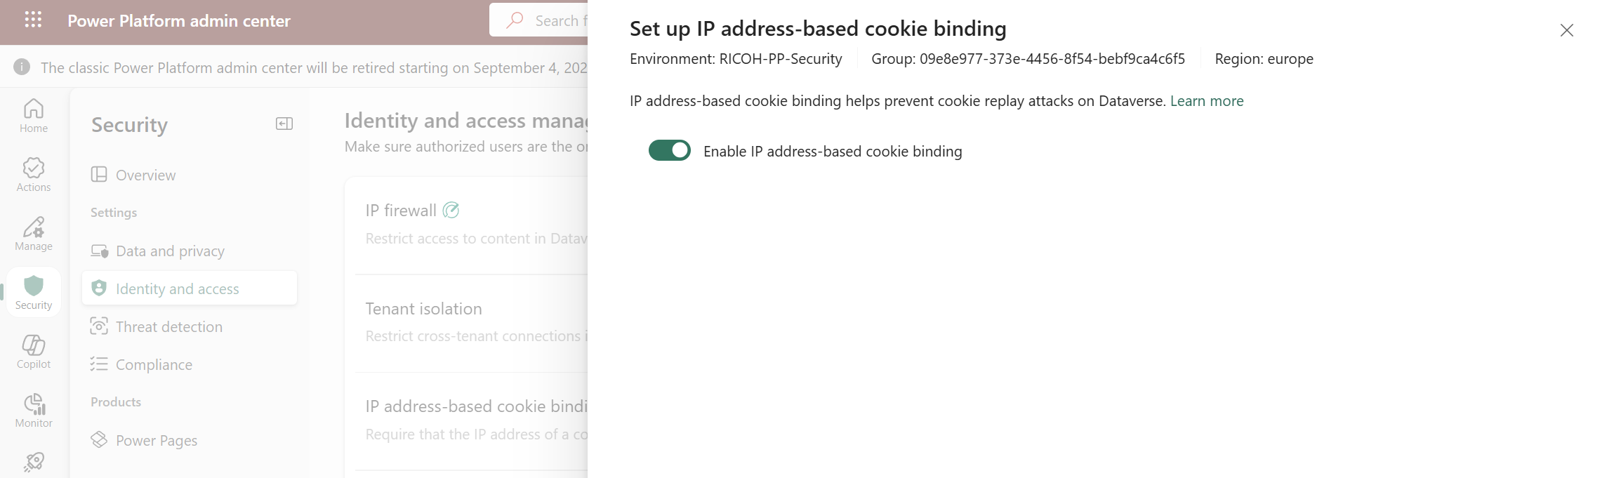
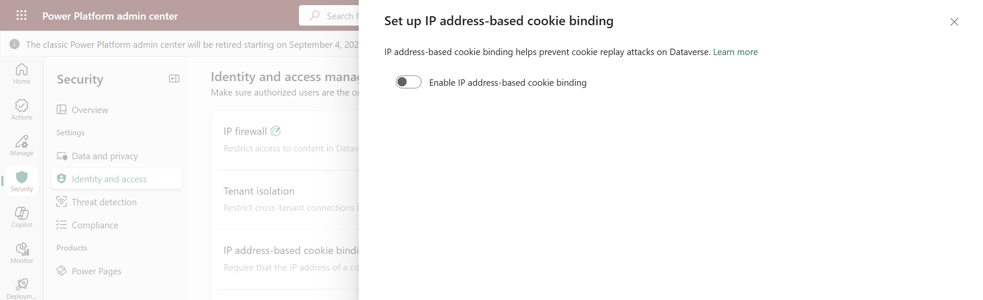
Securizando la Identidad, el Acceso y la Red en la Power Platform
Safeguarding Dataverse sessions with IP cookie binding - Power Platform | Microsoft Learn – Para un entorno o un Grupo de Entornos
Habilitar/Deshabilitar la configuración
3
Identity & Access Settings
1
IP-address cookie binding
2

Slide 33
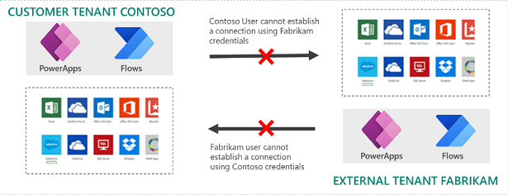
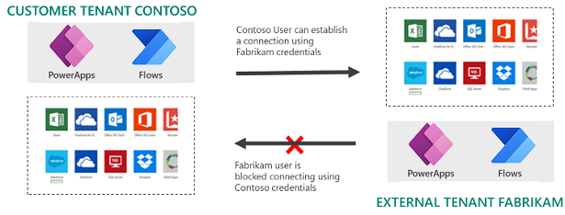
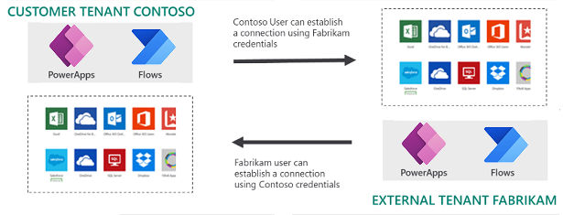
Securizando la Identidad, el Acceso y la Red en la Power Platform
Restrict cross-tenant inbound and outbound access - Power Platform | Microsoft Learn – Escenarios

Slide 34
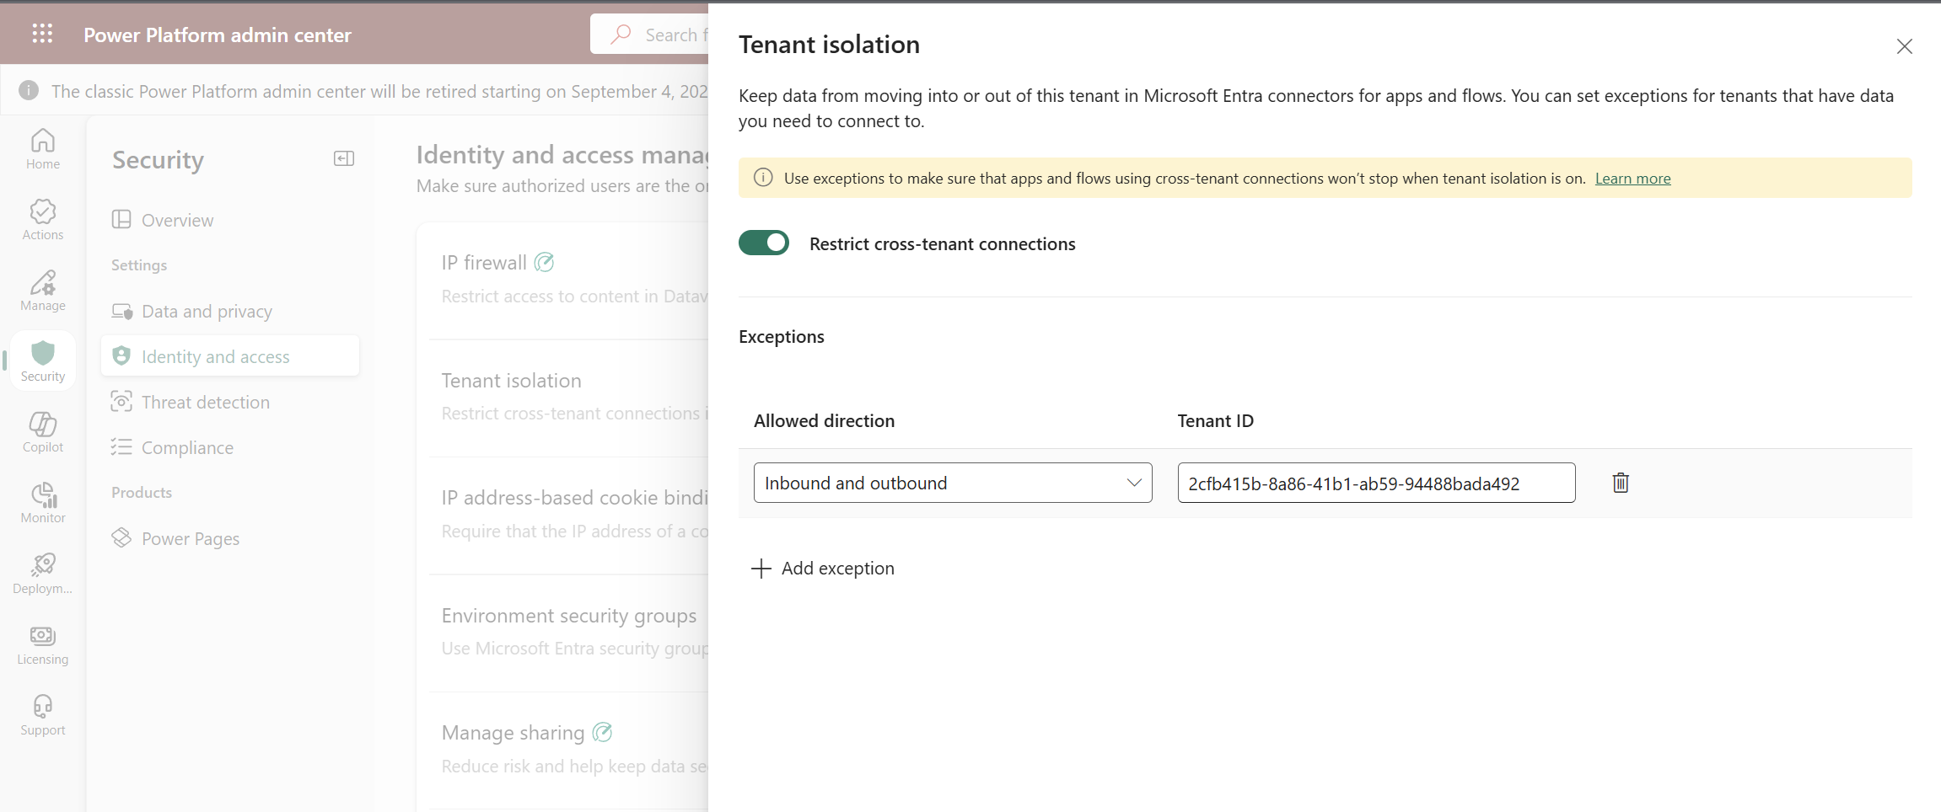
Securizando la Identidad, el Acceso y la Red en la Power Platform
Restrict cross-tenant inbound and outbound access - Power Platform | Microsoft Learn
Tenant Isolation habilitado en el tenant
2
Identity and access settings
1
Las excepciones se pueden configurar en 1 o 2 direcciones
3

Slide 35
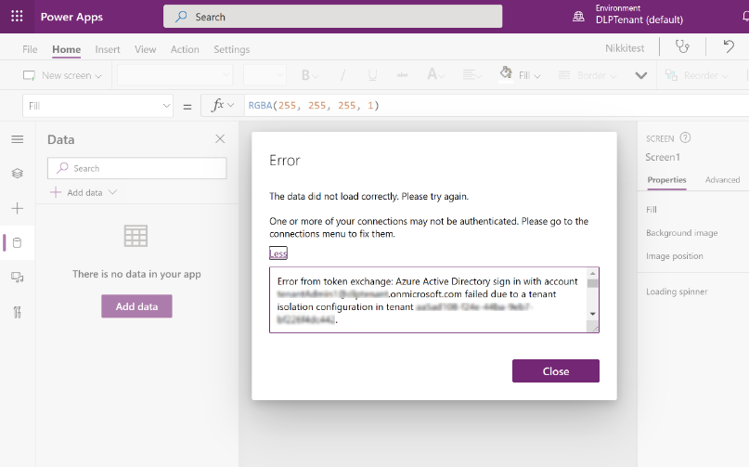
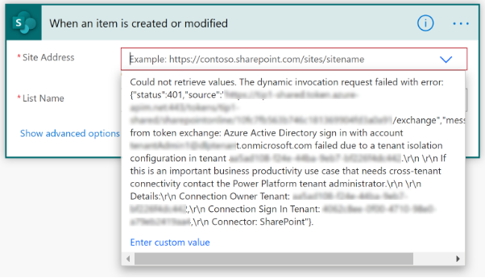
Securizando la Identidad, el Acceso y la Red en la Power Platform
Impacto en Flujos de Power Automate y Aplicaciones

Slide 36
DEMO #3
Seguridad de Identidad y Acceso – Parte I
Notes:
IP Firewall: Environment Level vs. Environment Group Level
Manage Sharing: Environment vs. Environment Group Level
IP Cookie Binding
Tenant Isolation

Slide 37
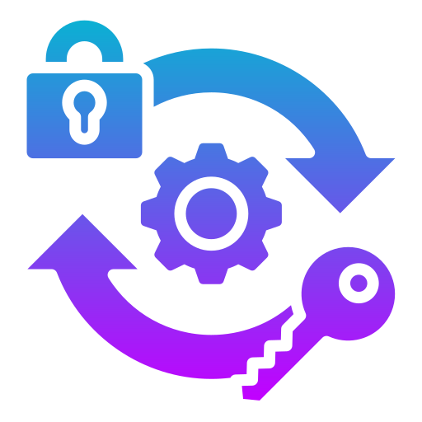
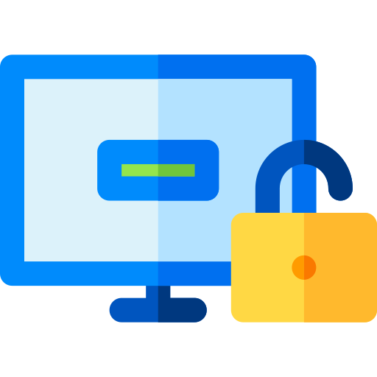


Securizando la Identidad, el Acceso y la Red en la Power Platform
Asegurar que solo los usuarios autorizados pueden acceder a ciertos recursos
Se fuerza el acceso con rol de administrador justo cuando se necesita
Se minimiza el # de usuarios con privilegios y el tiempo de acceso
Se reduce el riesgo de acceso autorizado a datos sensibles / usuarios “maliciosos” ganando acceso
Controlar que aplicaciones se permiten/no se permiten en un entorno (Managed Environments)
Previene fugas de datos controlando estas aplicaciones
Bloquear/Permitir el acceso en base directicas organizativas relativas a pertenencia, direcciones IP, dispositivo, detección de riesgos, etc
Bloquear / Permitir acceso de invitados a entornos de Power Platform
Deshabilitar el Acceso anónimo a Agentes
Establecer el método preferido de autenticación para Agentes
Privilege Identity Management
Acceso de Aplicaciones de Cliente
Acceso Condicional + Acceso de Invitados
Acceso y Autenticación de Agentes
Notes:
Identity and access management: Ensure that only authorized users can access specific resources, through features such as IP firewall, IP cookie binding, Manage sharing, conditional access policies for individual apps, managed identities for Dataverse plug-ins, and privileged access.
Identity & Acces Management + Network Security: IP Firewall | Resource sharing limits | IP cookie binding | Tenant Isolationt | PIM | Client app Access | Conditional Access for Individual Canvas Apps | Agent Access & Authentication
Privileged Identity Management:
Enforce on-demand, just-in-time administrative access when needed
Minimize number of privileged users (admins) and duration of access
Reduce risks of authorized user impact on sensitive data / malicious user getting access
App Access Control: The app access control feature applies only to Managed Environments. It prevents data exfiltration by controlling which apps are allowed and blocked in each environment. Learn more in Control which apps are allowed in your environment.
Agent Controls:
Use new governance controls to limit agent sharing, turn off anonymous access, enforce preferred authentication providers, and provide better security. These controls help reduce the risks of data exfiltration, ensure agent development meets all organizational governance requirements, and proactively reduce security risks.
Agent Authentication: This feature allows administrators to configure authentication for all agent interactions in the environment.
Agent Access: This feature gives administrators control over where agents can be published, allowing customer engagement across multiple platforms. Admins can select multiple available channels, such as Microsoft Teams, Direct Line, Facebook, Dynamics 365 for Customer Service, SharePoint, and WhatsApp.

Slide 38
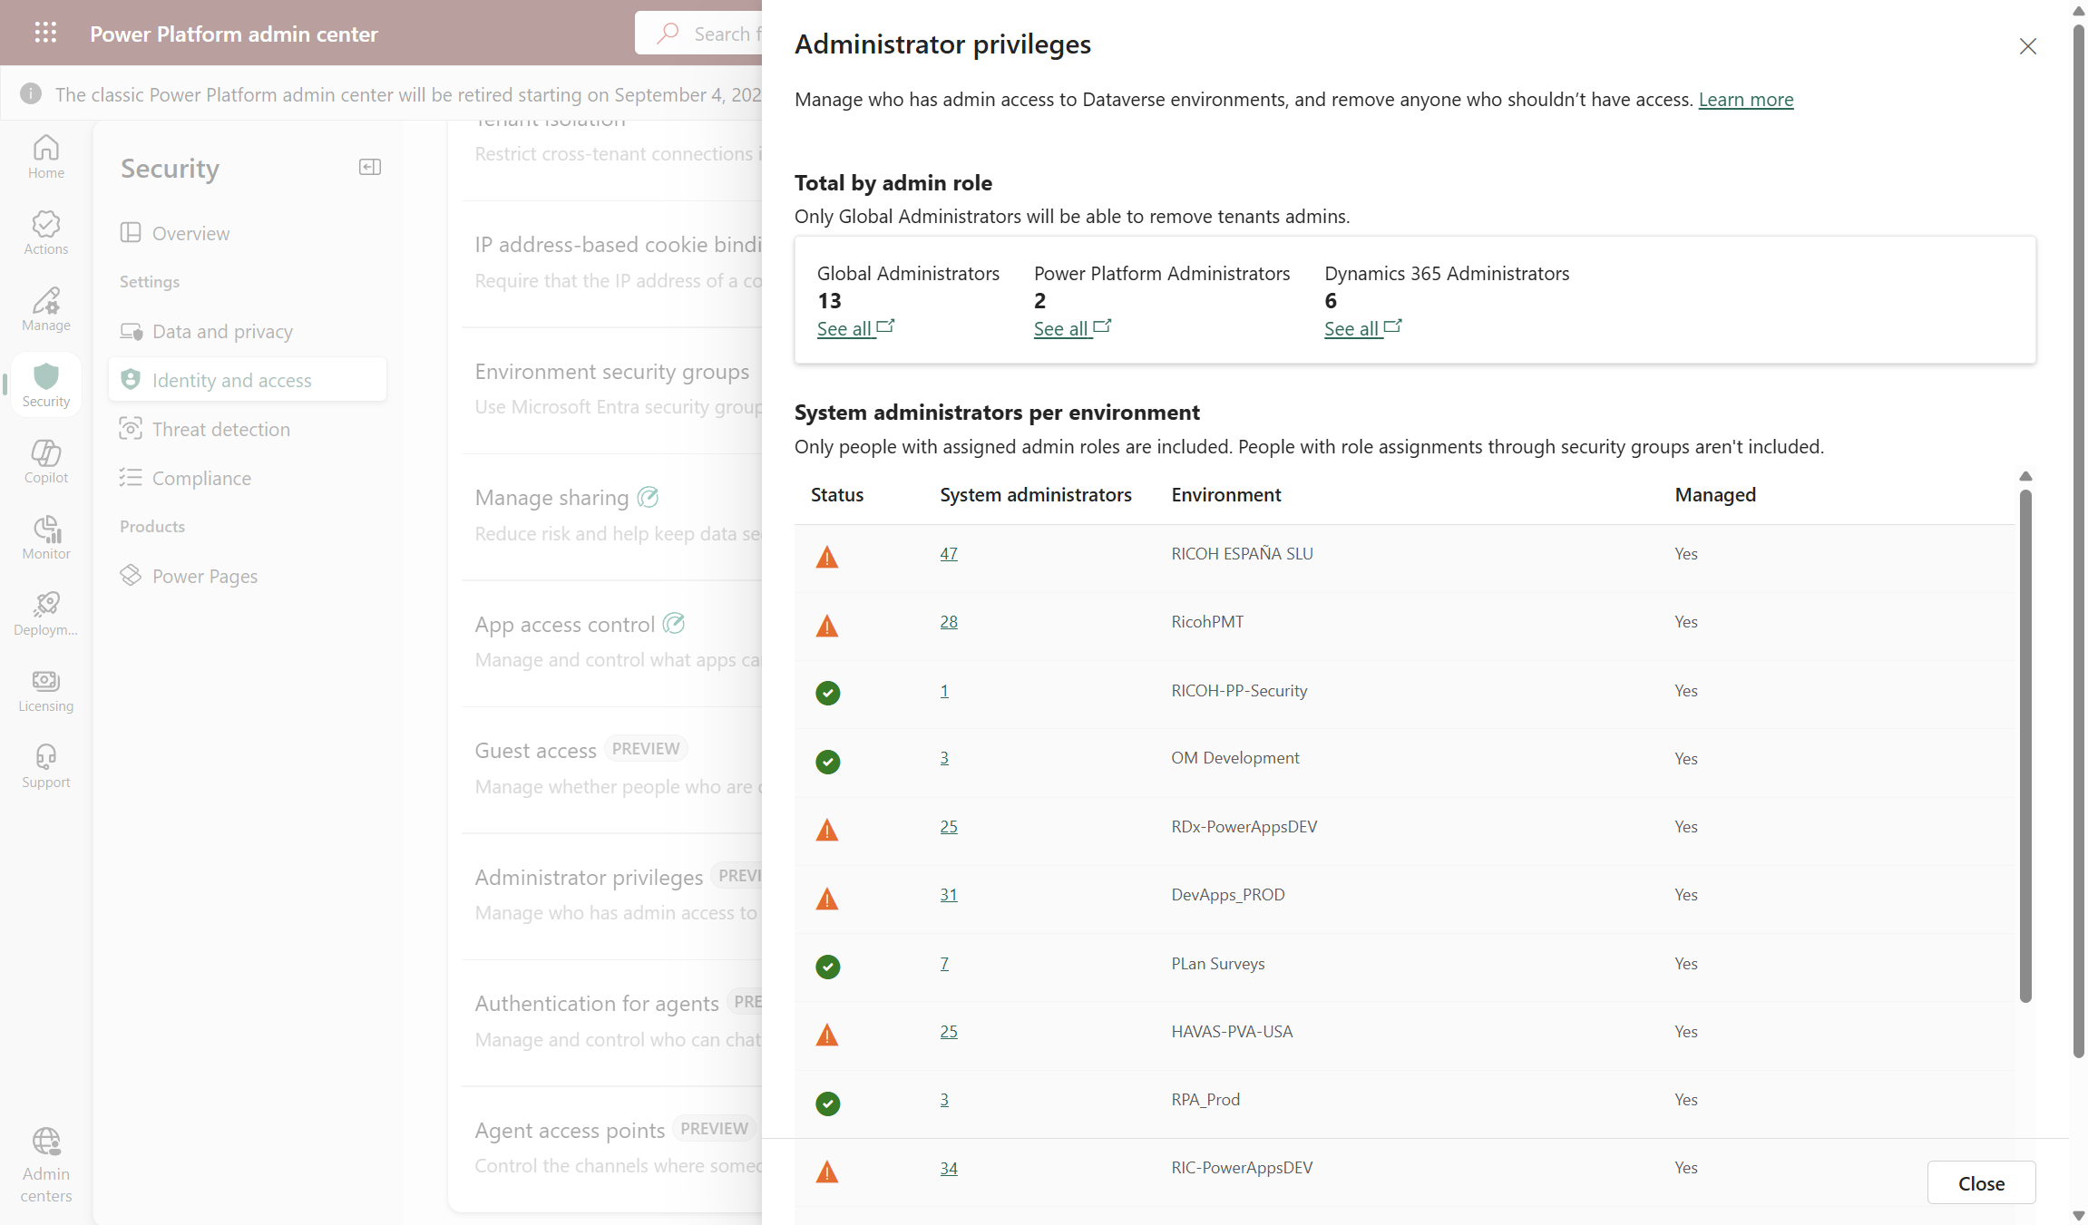
Securizando la Identidad, el Acceso y la Red en la Power Platform
Revisar el acceso con privilegios de administración a la Power Platform (Preview)
“Postura” de acceso con privilegios de administración
Identity & Access Settings
3
1
Administrator privileges setting
2

Slide 39
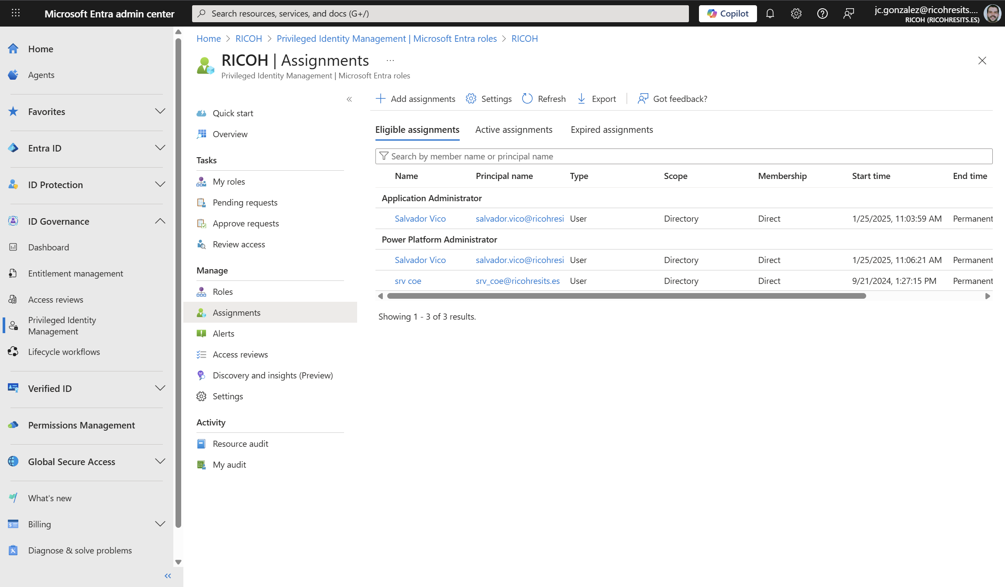
Securizando la Identidad, el Acceso y la Red en la Power Platform
Use Entra Privileged Identity Management in Power Platform admin center to manage high-privileged admin roles - Power Platform | Microsoft Learn – Ojo a las limitaciones!!!
Roles elegibles de Power Platform Admin Center
Ojo a las limitaciones como administradores de entornos!!
Notes:
Microsoft no longer automatically assigns the System Administrator role to users with global or service level admin roles such as Power Platform Administrator and Dynamics 365 Administrator.
These admins can continue to sign in, to the Power Platform admin center, with these privileges:
Enable or disable tenant level settings
View analytics information for environments
View capacity consumption
These admins can't perform activities that require direct access to Dataverse data without a license. Examples of these activities include:
Updating the security role for a user in an environment
Installing apps for an environment

Slide 40
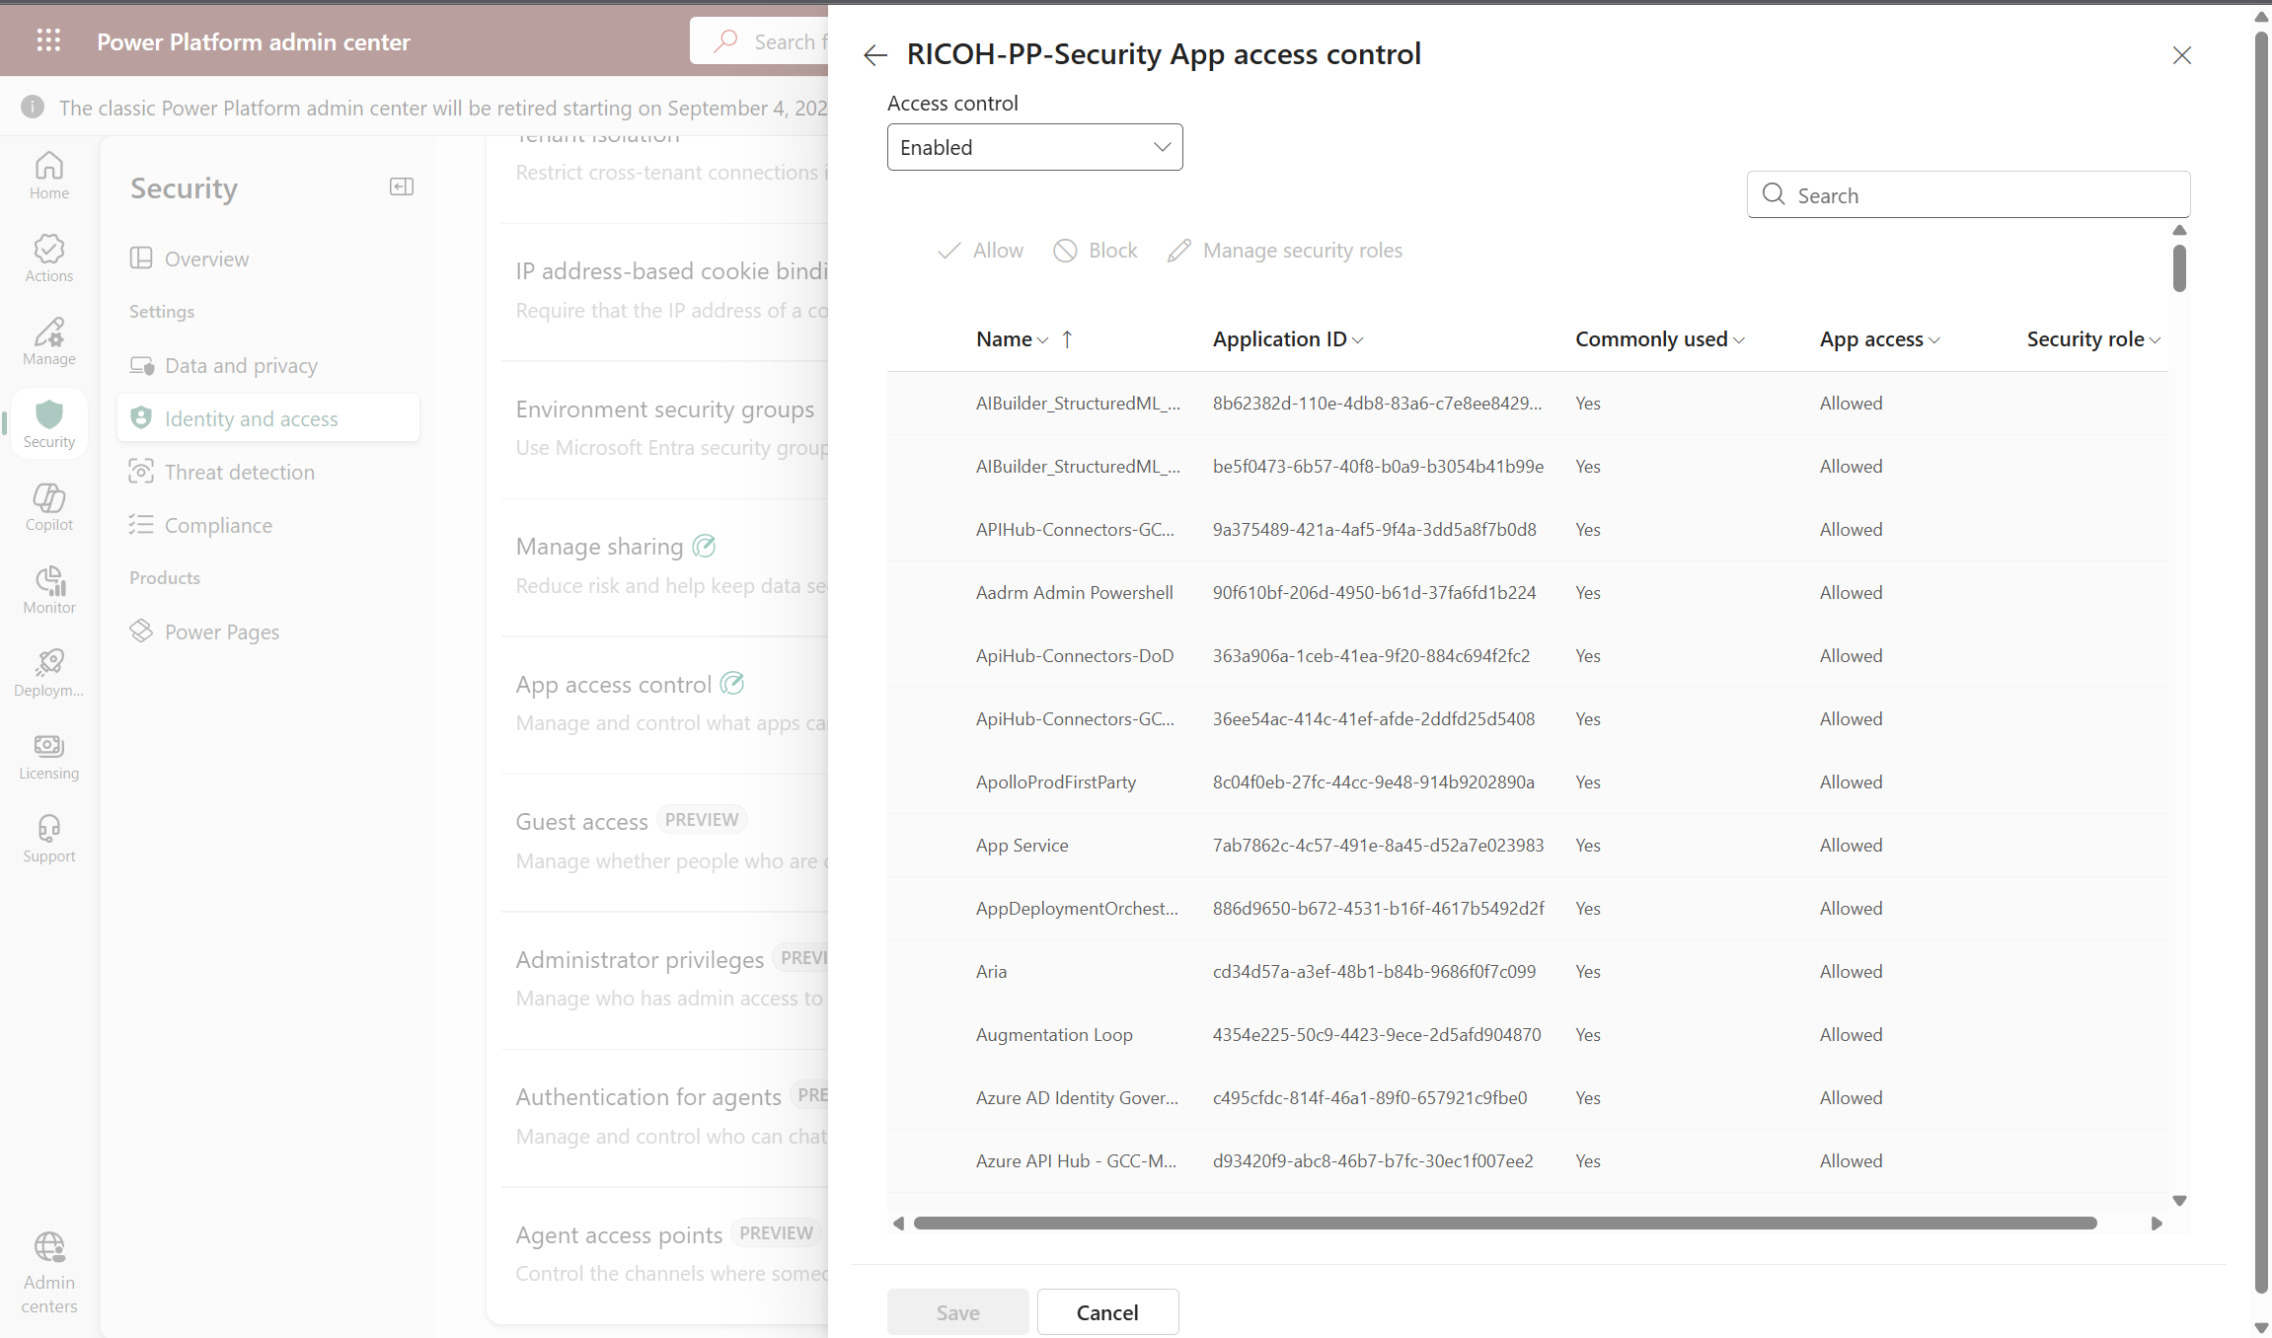
Securizando la Identidad, el Acceso y la Red en la Power Platform
Control which apps are allowed in your environment - Power Platform | Microsoft Learn
Permitir / Bloquear el acceso de aplicaciones al entorno
3
Identity & Access Settings
1
App access control setting
2

Slide 41
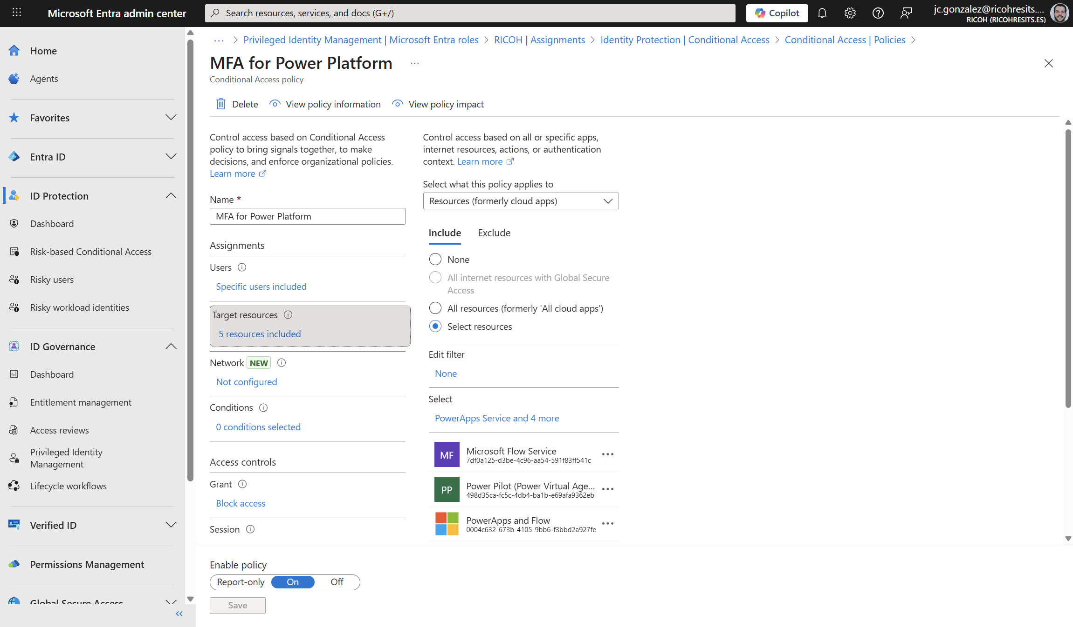
Securizando la Identidad, el Acceso y la Red en la Power Platform
Block access by location with Microsoft Entra Conditional Access - Power Platform | Microsoft Learn
Acceso Condicional para el acceso a la Power Platform

Slide 42
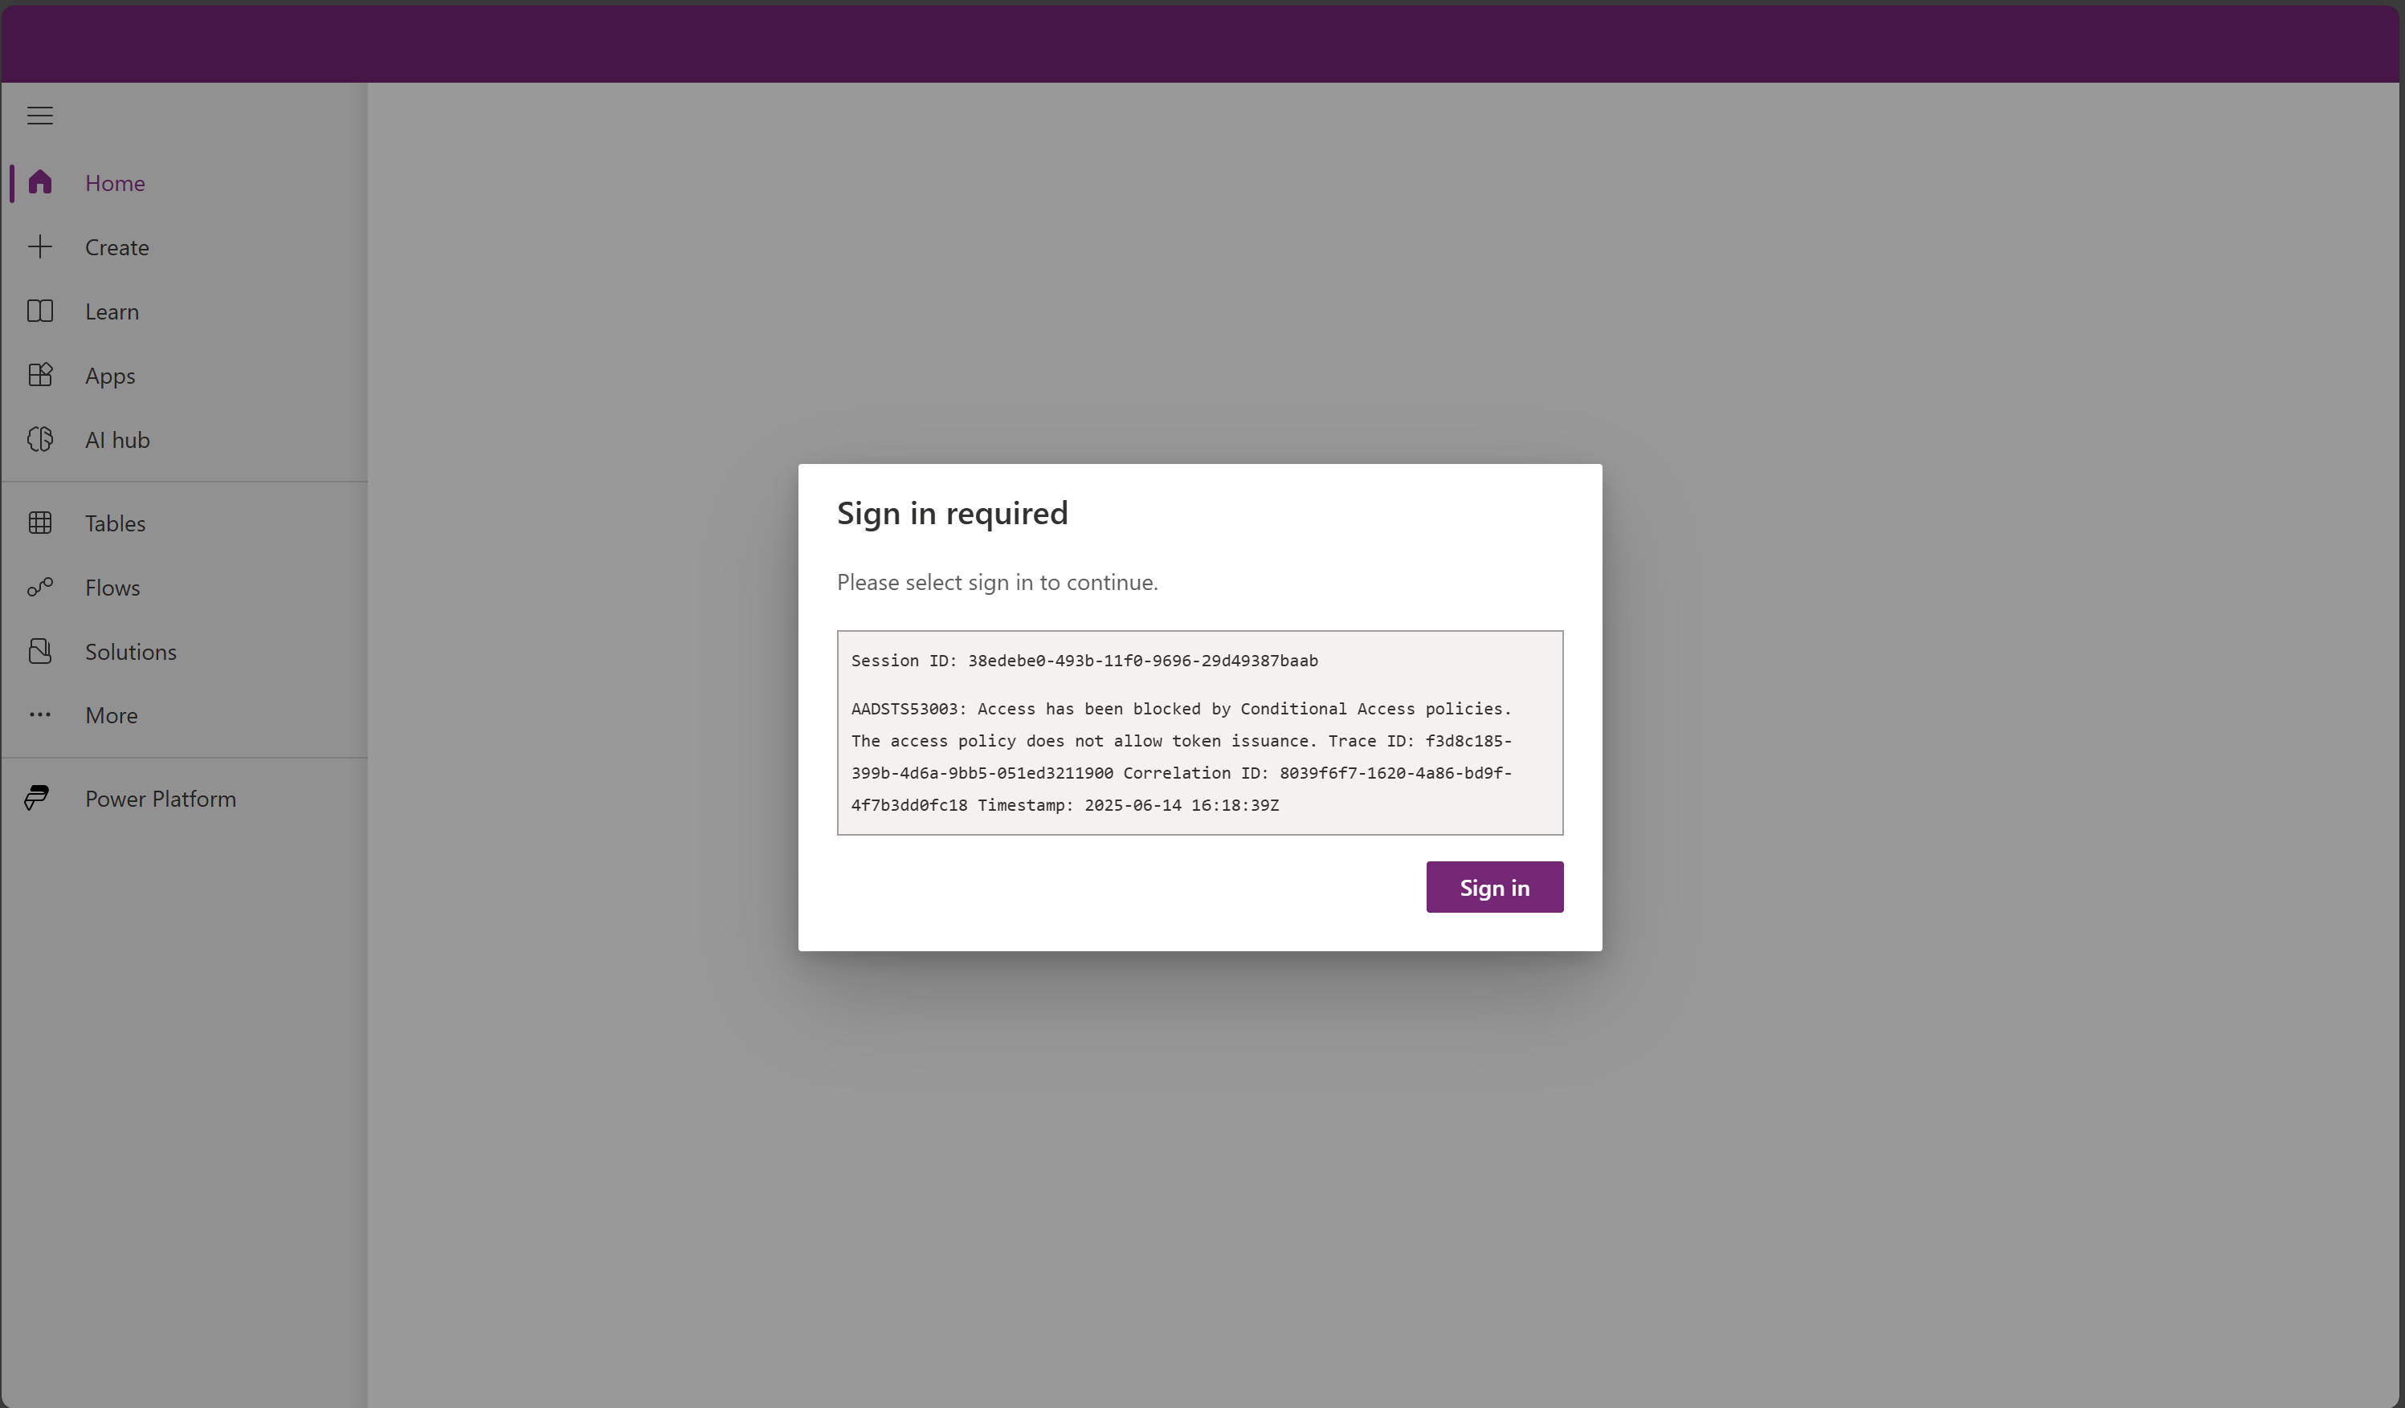
Securizando la Identidad, el Acceso y la Red en la Power Platform
Experiencia de Usuario en Power Apps

Slide 43
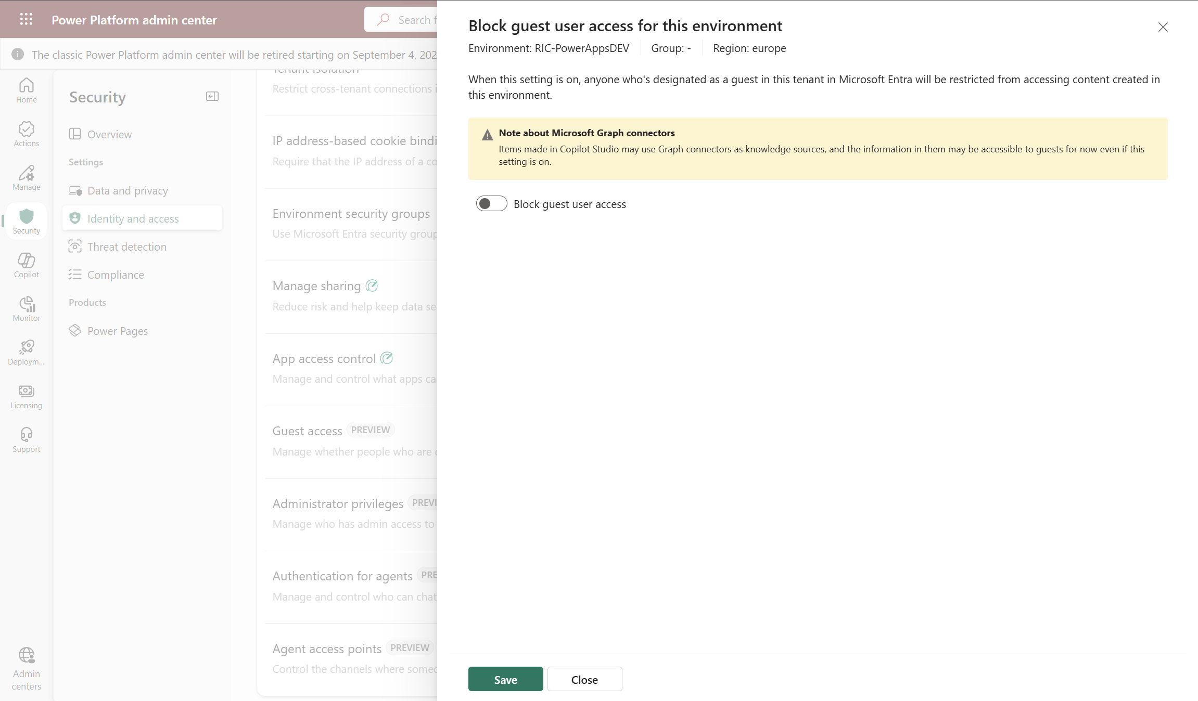
Securizando la Identidad, el Acceso y la Red en la Power Platform
Bloqueo de Invitados en Entornos de Power Platform (Alternativa al uso de Acceso Condicional) - Permit or deny guest access to an environment | Microsoft Learn
Habilitar/Deshabilitar acceso de invitados para el entorno
Identity & Access Settings
3
Guest access setting
2
1
Notes:
When an admin configures this environment setting, guests can't connect to data sources in the environment. Guests can't perform any maker actions, and they can't use any apps or flows shared with them. Admins implement this security within the Power Platform admin center without using controls like conditional access or continuous access evaluation.

Slide 44
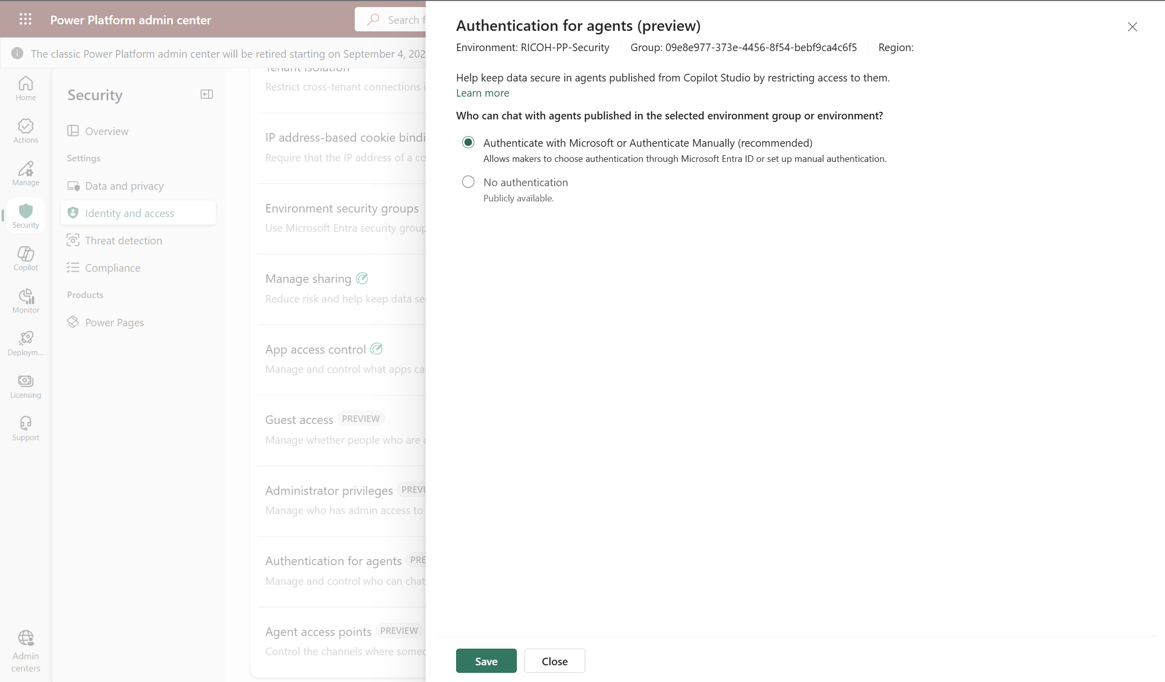
Securizando la Identidad, el Acceso y la Red en la Power Platform
Manage agent security with enhanced admin controls | Microsoft Learn – Autenticación para Agentes: Configurable a nivel de entorno o de Grupo de entornos
Configuración de la autenticación de Agentes
3
Identity & Access Settings
1
Autenticación para Agentes
2
Notes:
This feature allows administrators to configure authentication for all agent interactions in the environment. Admins can select one of the following options:
Authenticate with Microsoft or Authenticate Manually allows you to force authentication through Microsoft Entra ID or authenticate manually. This helps prevent makers from creating or using agents with no authentication.
No authentication allows anonymous access.

Slide 45
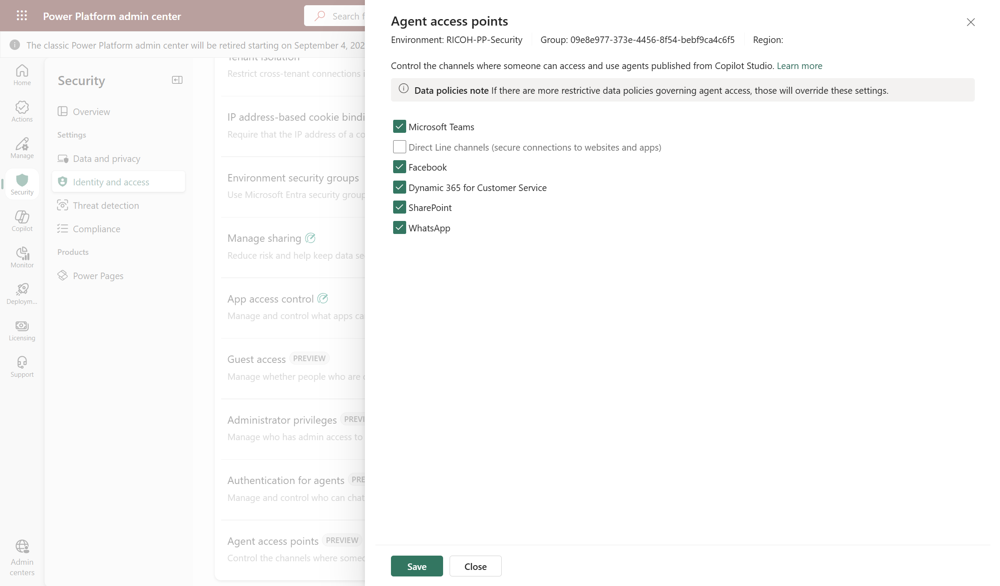
Securizando la Identidad, el Acceso y la Red en la Power Platform
Manage agent security with enhanced admin controls | Microsoft Learn – Canales de Acceso a Agentes: Configurable a nivel de entorno o de Grupo de entornos
Configuración de Canales donde los Agentes están disponibles
3
Identity & Access Settings
1
Acceso de Agentes
2
Notes:
This feature gives administrators control over where agents can be published, allowing customer engagement across multiple platforms. Admins can select multiple available channels, such as Microsoft Teams, Direct Line, Facebook, Dynamics 365 for Customer Service, SharePoint, and WhatsApp.

Slide 46
DEMO #4
Seguridad de Identidad y Acceso – Parte II
Notes:
PIM
Block/Enable Client Access App
Conditional Access + Guest Access
Agents Authentication + Agent Access

Slide 47



Auditoría y Cumplimiento
Salvaguardar los datos organizativos cumpliendo regulaciones específicas + Visibilidad en todo momento de la actividad de Usuario, Administradores y las Aplicaciones
Extiende el acceso JIT con un nivel de aprobación x cliente
Ligado a un entorno, usuario y duración específicas
Auditoria de serie para el usuario final
Por defecto zona geográfica del tenant
Soporte multi-geo a nivel de entornos (Escenarios multinacionales)
Resiliencia de los datos garantizada en cada zona geográfica
Regulaciones nacionales, regionales y de la industria para la recogida y uso de datos
Ejemplos: FedRamp, FERPA, HIPAA, SOC, IRS 1075, SEC Regulation, FISC (Japan), FACT (UK), etc
Cumplimiento GDPR
Microsoft Trust Center
Customer Lockbox
Ubicación de los Datos
Cumplimiento de Estándares
Privacidad de los Datos
Notes:
Customer Lockbox
Extendss JIT with customer approval
Bound to specific environment, user and duration
OOB audit available to end user
Data residency
Tenant home geo default
Multi-geo support (at environment level) to enable global presence
Data resiliency ensured within geo
Compliance standards
National, regional and industry-specific regulations for data collection and use
E.g., FedRamp, FERPA, HIPAA, SOC, IRS 1075, SEC Regulation, FISC (Japan), FACT (UK), etc.
Data Privacy
GDPR compliant
Microsoft Trust Center

Slide 48

Auditoría y Cumplimiento
Securely access customer data using Customer Lockbox in Power Platform and Dynamics 365 - Power Platform | Microsoft Learn
Habilitar/Deshabilitar Customer Lockbox
3
Acceso a Compliance settings
Acceso a Customer Lockbox
2
1
Notes:
Auditoría y Cumplimiento
Compliance: Implement robust compliance measures to safeguard organizational data and ensure adherence to industry regulations through features such as Customer Lockbox.
Compliance: Lockbox | Dataverse Audid

Slide 49




Auditoría y Cumplimiento
Salvaguardar los datos organizativos cumpliendo regulaciones específicas + Visibilidad en todo momento de la actividad de Usuario, Administradores y las Aplicaciones
Acceso de usuario y actividad (cambios en registros)
Monitorización de Jobs del Sistema
Auditoría de Jobs de borrado
Gestión de registros de Logs
Dataverse, Power Apps, Power Automate, Power Pages, Conectores, DLP
Auditoría Interna y Externa
Auditoría de cambios en registros y acceso de usuarios
Actividades realizadas en Entornos por Administradores
Actividades relativas a ciclo de vida, cambios en propiedades y configuraciones, cambios en seguridad y permisos
Auditoría de Dataverse
Logging de Actividad
Logging de Actividad de Administradores
Capturar, registrar, descubrir y retener información del Log de Auditoría
Auditoría de Microsoft Purview
Notes:
Dataverse Audit
User access and activity (records changes)
Monitor system jobs
Audit delete jobs
Manage log records
Activity Logging
Dataverse, Power Apps, Power Automate, Connector*, DLP activity
Internal and external audit
Audit changes to records and user access
Admin Activity Logging
Activities performed on Environments by the Power Platform Administrator
Lifecycle operations, property and setting change activities, security and permission change activities
Microsoft 365 Purview Audit
Capture, record, discover and retain your organization's unified audit log

Slide 50
DEMO #4
Auditoría y Cumplimiento
Notes:
Dataverse Audit
Purview Audit

Slide 51




Protección frente a amenazas
Protege de forma proactiva tus activos organizativos en la Power Platform a través de la detección y remediación de amenazas
Análisis estático de los objetos de una solución contra una serie de buenas prácticas
Identificación rápida de patrones problemáticos en la solución
Disponible en Managed Environments
Monitorizar y detectar actividades sospechosas y maliciosas en entornos de la Power Platform
Se monitoriza la ejecución desde geografías no esperadas, borrado de datos sospechoso y otros
Monitorizar capacidades y seguridad en agentes mediante un sistema externo de detección de amenazas
Si se detectan acciones sospechosas, el sistema puede bloquear la ejecución del agente
Sistemas Externos: Custom | Microsoft Defender | 3 Party
Monitoriza el comportamiento de Agentes de Copilot Studio para detectar ataques de inyección de prompt de dominio cruzado (XPIA) en tiempo real
Inspección de Mensajes antes de que el Agente haga nada y bloqueo de estos si son sospechosos
Solution Checker
Integración con Microsoft Sentinel
Detección de Amenazas para Agentes
Microsoft Defender para Agentes
Notes:
Protección frente a amenazas
Threat protection: Protect your organization's assets and resources through unified detection by using Microsoft Sentinel solution for Power Platform. This solution allows for intelligent detection and responses to suspicious activities, such as mass data deletion or unauthorized app execution. In this way, it enhances your security posture and effectively mitigates potential threats.
Thread Protection: Solution Checker | Microsoft Sentinel Integration | Thread Detection for Copilot Agents | Microsoft Defender for Copilot Agents
-------------------------------------------------------------------------------------------------------------
Solution Checker: The solution checker is a powerful tool that performs a comprehensive static analysis of your solution objects against a set of best practice rules. By using solution checker, you can quickly identify problematic patterns in solution components and receive detailed reports that highlight issues, affected components, and provide links to documentation on how to resolve each issue.
Microsoft Sentinel Integration: Monitor and detect suspicious or malicious activities in your Power Platform environment. Monitor and secure your Dynamics 365 Customer Engagement environment, which uses the Microsoft Dataverse common data store known as
Thread Detection and Protection for Copilot Studio: Custom agents created in Copilot Studio are secure by default. They include built-in protection against various threats, such as user prompt-injection attacks (UPIA) and cross-domain prompt injection Attacks (XPIA). At runtime, the agent blocks attacks of these types, reducing the risk of data exfiltration.
To further increase the monitoring capabilities and security of custom agents, Copilot Studio lets organizations configure external threat detection systems for enhanced oversight. These tools operate during the agent's runtime, continuously evaluating agent activity. If the system detects any suspicious tools or actions, it can intervene to block them from executing. This threat detection provides an extra layer of real-time protection and compliance enforcement.
Microsoft Defender – Copilot Studio AI Agents: Microsoft Defender is providing new detection capabilities to secure Copilot Studio AI Agents from oversharing, misconfiguration, etc. It monitors agent behavior in your tenant and helps detect cross-domain prompt injection attacks (XPIA) in real time.

Slide 52

Protección frente a amenazas
Solution checker enforcement in Managed Environments - Power Platform | Microsoft Learn – Configurable para un entorno o un Grupo de Entornos
Notes:
Solution Checker: The solution checker is a powerful tool that performs a comprehensive static analysis of your solution objects against a set of best practice rules. By using solution checker, you can quickly identify problematic patterns in solution components and receive detailed reports that highlight issues, affected components, and provide links to documentation on how to resolve each issue.

Slide 53

Protección frente a amenazas
Enable external threat detection and protection for Copilot Studio custom agents (preview) - Microsoft Copilot Studio | Microsoft Learn
Acceso a Additional Thread Detection
2
Acceso a Thread Detection settings
1
Configuraciones del Sistema Externo de Detección de Amenazas
3
Notes:
Thread Detection and Protection for Copilot Studio: Custom agents created in Copilot Studio are secure by default. They include built-in protection against various threats, such as user prompt-injection attacks (UPIA) and cross-domain prompt injection Attacks (XPIA). At runtime, the agent blocks attacks of these types, reducing the risk of data exfiltration.
To further increase the monitoring capabilities and security of custom agents, Copilot Studio lets organizations configure external threat detection systems for enhanced oversight. These tools operate during the agent's runtime, continuously evaluating agent activity. If the system detects any suspicious tools or actions, it can intervene to block them from executing. This threat detection provides an extra layer of real-time protection and compliance enforcement.
Copilot Studio supports a flexible "bring your own protection" approach. Organizations have the freedom to integrate security solutions that best fit their unique requirements.
Options include:
Develop your own custom monitoring tools, or have someone develop them for you. For more information on how to set up the system endpoint so that your agent can connect to it, see Build a runtime threat detection system for Copilot Studio agents
Apply a robust enterprise solution by Microsoft Defender
Use products from other trusted security providers

Slide 54

Protección frente a amenazas
Enable external threat detection and protection for Copilot Studio custom agents (preview) - Microsoft Copilot Studio | Microsoft Learn
Notes:
Thread Detection and Protection for Copilot Studio: Custom agents created in Copilot Studio are secure by default. They include built-in protection against various threats, such as user prompt-injection attacks (UPIA) and cross-domain prompt injection Attacks (XPIA). At runtime, the agent blocks attacks of these types, reducing the risk of data exfiltration.
To further increase the monitoring capabilities and security of custom agents, Copilot Studio lets organizations configure external threat detection systems for enhanced oversight. These tools operate during the agent's runtime, continuously evaluating agent activity. If the system detects any suspicious tools or actions, it can intervene to block them from executing. This threat detection provides an extra layer of real-time protection and compliance enforcement.
Copilot Studio supports a flexible "bring your own protection" approach. Organizations have the freedom to integrate security solutions that best fit their unique requirements.
Options include:
Develop your own custom monitoring tools, or have someone develop them for you. For more information on how to set up the system endpoint so that your agent can connect to it, see Build a runtime threat detection system for Copilot Studio agents
Apply a robust enterprise solution by Microsoft Defender
Use products from other trusted security providers

Slide 55

Protección frente a amenazas
Real-time protection during agent runtime for Microsoft Copilot Studio AI agents (Preview) - Microsoft Defender for Cloud Apps | Microsoft Learn
Acceso a Microsoft Defender – Copilot Studio
2
Habilitar Microsoft Defender para Agentes de Copilot Studio
3
Acceso a Thread Detection settings
1
Notes:
Thread Detection and Protection for Copilot Studio: Custom agents created in Copilot Studio are secure by default. They include built-in protection against various threats, such as user prompt-injection attacks (UPIA) and cross-domain prompt injection Attacks (XPIA). At runtime, the agent blocks attacks of these types, reducing the risk of data exfiltration.
Real-time protection during agent runtime in Microsoft Defender reduces these risks by inspecting user messages before the agent runs any actions.
If Microsoft Defender determines that a prompt is suspicious:
The tool invocation is blocked before it runs.
The user gets notified that their message was blocked.
An informative alert is created and appears in the Microsoft Defender portal under XDR Incidents and Alerts.
This capability adds another security layer on top of Microsoft Copilot Studio, helping ensure AI agents remain resilient against evolving threats.

Slide 56
DEMO #5
Protección frente a amenazas
Notes:
Solution Checker
Additional Thread Detection
Microsoft Defender

Slide 57
Referencias (1/3)
Managed security - Power Platform | Microsoft Learn
Manage your customer-managed encryption key - Power Platform | Microsoft Learn
Create and manage masking rules (preview) - Power Platform | Microsoft Learn
Connect to and manage Microsoft Dataverse in Microsoft Purview | Microsoft Learn
Data policies for Managed Environments - Power Platform | Microsoft Learn
Connector action control - Power Platform | Microsoft Learn
Connector endpoint filtering (preview) - Power Platform | Microsoft Learn
Virtual Network support overview - Power Platform | Microsoft Learn
Identity and access management - Power Platform | Microsoft Learn
Notes:
Protección frente a amenazas
Threat protection: Protect your organization's assets and resources through unified detection by using Microsoft Sentinel solution for Power Platform. This solution allows for intelligent detection and responses to suspicious activities, such as mass data deletion or unauthorized app execution. In this way, it enhances your security posture and effectively mitigates potential threats.

Slide 58
Referencias (2/3)
IP firewall in Power Platform environments - Power Platform | Microsoft Learn
Limit sharing - Power Platform | Microsoft Learn
Safeguarding Dataverse sessions with IP cookie binding - Power Platform | Microsoft Learn
Use Entra Privileged Identity Management in Power Platform admin center to manage high-privileged admin roles - Power Platform | Microsoft Learn
Block access by location with Microsoft Entra Conditional Access - Power Platform | Microsoft Learn
Permit or deny guest access to an environment | Microsoft Learn
Identity and access management - Power Platform | Microsoft Learn
Notes:
Protección frente a amenazas
Threat protection: Protect your organization's assets and resources through unified detection by using Microsoft Sentinel solution for Power Platform. This solution allows for intelligent detection and responses to suspicious activities, such as mass data deletion or unauthorized app execution. In this way, it enhances your security posture and effectively mitigates potential threats.

Slide 59
Referencias (3/3)
Securely access customer data using Customer Lockbox in Power Platform and Dynamics 365 - Power Platform | Microsoft Learn
Manage Dataverse auditing - Power Platform | Microsoft Learn
Solution checker enforcement in Managed Environments - Power Platform | Microsoft Learn
Microsoft Sentinel Solution for MS Business Apps | Microsoft Learn
Enable external threat detection and protection for Copilot Studio custom agents (preview) - Microsoft Copilot Studio | Microsoft Learn
Real-time protection during agent runtime for Microsoft Copilot Studio AI agents (Preview) - Microsoft Defender for Cloud Apps | Microsoft Learn
Notes:
Protección frente a amenazas
Threat protection: Protect your organization's assets and resources through unified detection by using Microsoft Sentinel solution for Power Platform. This solution allows for intelligent detection and responses to suspicious activities, such as mass data deletion or unauthorized app execution. In this way, it enhances your security posture and effectively mitigates potential threats.

Slide 60

So…
Any Question?

Slide 61

Office 365 for IT Pros
https://o365itpros.gumroad.com/l/O365IT

Slide 62
¡Gracias!
¡Gracias!

Slide 63

Redes sociales y contacto
https://bizzsummit.es
https://twitter.com/bizzsummites
http://youtube.com/bizzsummites
info@bizzsummit.es

